Slide 1

Affordable Clean Energy For All
Schools Connect
Understanding the opportunities for inclusive solar electricity
through creativity, imagination and citizenship
Notes:
Main photo credit: Ecobricks
Source: http://www.ecobricks.org/bali-ecobricks/

Slide 2
    These slides have been produced to support the Affordable Clean Energy for All learning unit. They can only be used with the main resource, which includes full instructions on how to use them with your class and a partner school.

Slide 3
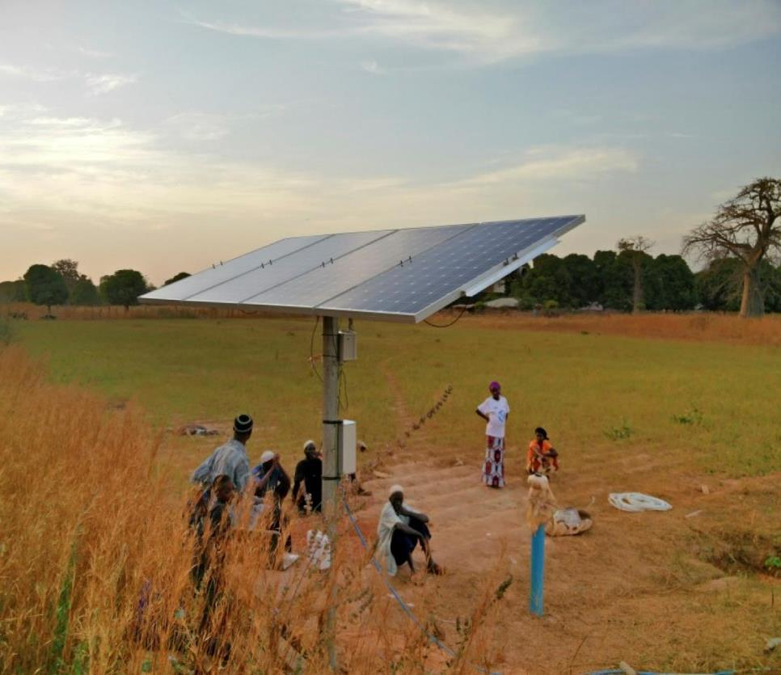
Different ways of generating electricity
Notes:
Lesson 1
Photo credit: Beverley Hodt
Source: Project Gambia

Slide 4
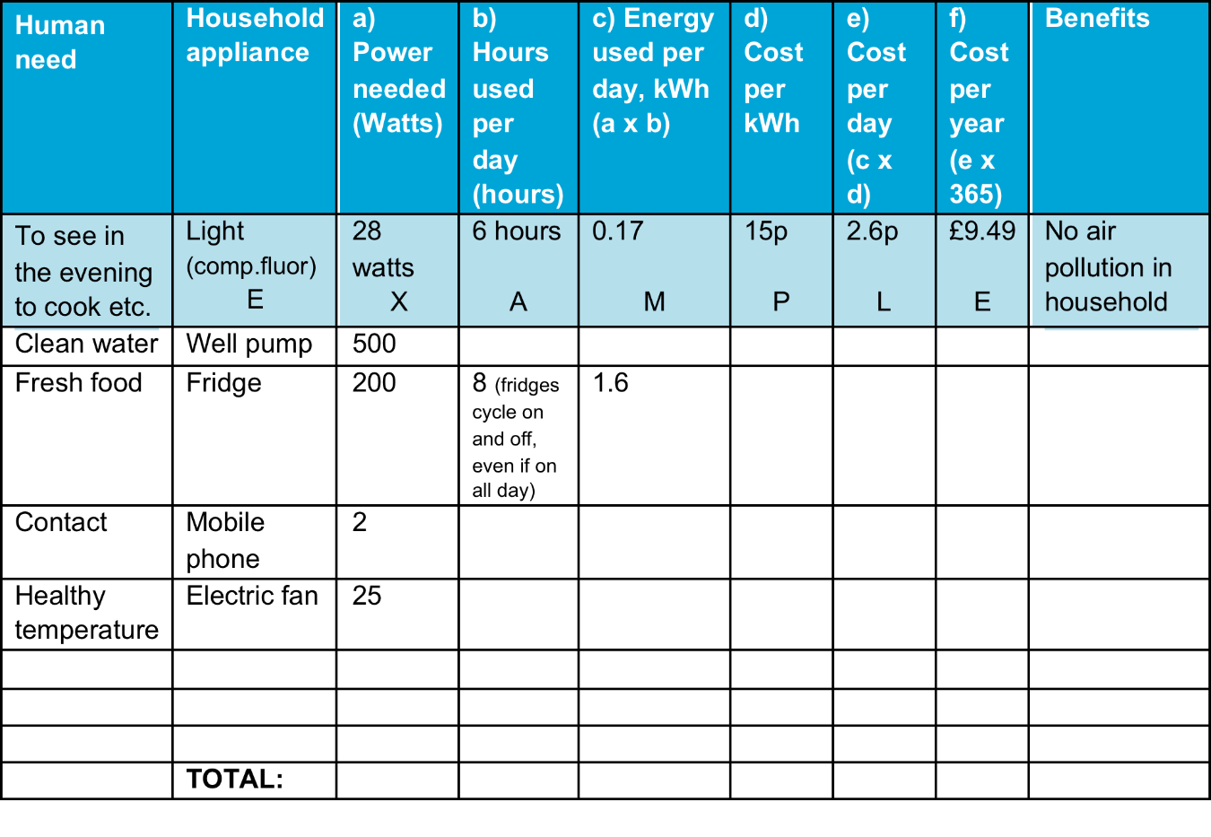
How much electricity do you need? (Lesson 1, Step3)
Notes:
Lesson 1, Step 3.
Source: Daft Logic
Further information on the power consumption of appliances can be found at https://www.daftlogic.com/information-appliance-power-consumption.htm

Slide 5
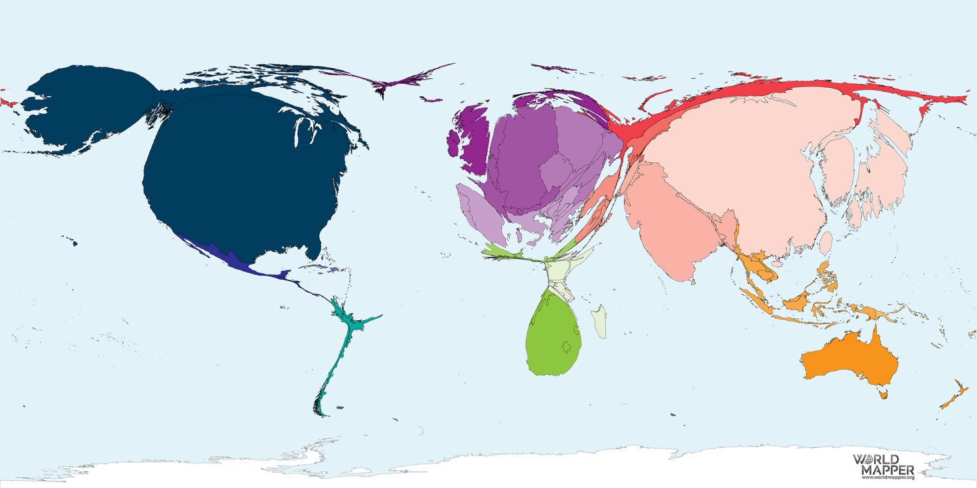
Coal consumption (Lesson 2)
Notes:
Lesson 2
Photo credit: WorldMapper
Source: https://worldmapper.org/maps/coal-power-2002/?sf_action=get_data&sf_data=results&_sft_product_cat=fuel
Notes: Of all sources, the most electricity is generated from coal. The United States, China and India generate the most coal electricity. In total, North American territories generate three times more electricity from coal than the total for territories in any other region. The United States makes up 93% of the North American total. The most coal generated electricity per person is in Australia – a large territory with a low population density. Electricity generation in Australia is 3000 times more per person than in the territory with the lowest coal electricity generation: the United Republic of Tanzania. Of the 200 territories, there is no electricity generation from coal in 71. (WorldMapper)
Two thirds of world electricity production come more or less from fossil fuel followed by hydroelectric plants 16.0%, nuclear plants 10.6%, biofuels and waste 2.2%, and geothermal, solar, wind and other sources make up the remaining 4.9%. However, the share of the last category is increasing very fast (http://energyatlas.iea.org/#!/tellmap/-1118783123)

Slide 6
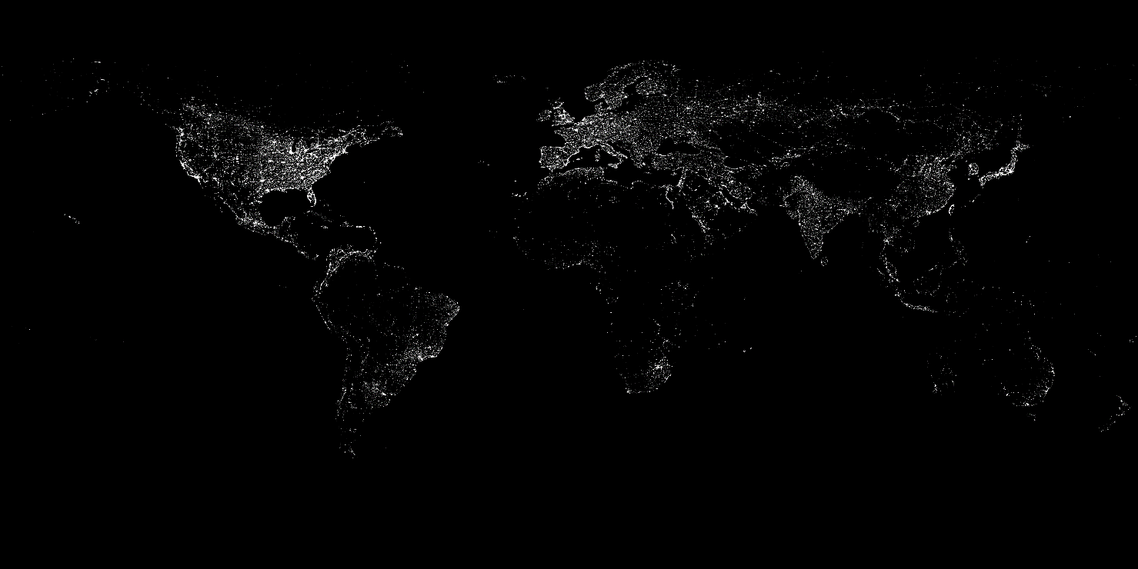
Notes:
Lesson 2
Photo credit: NASA
Source: https://eoimages.gsfc.nasa.gov/images/imagerecords/55000/55167/earth_lights.gif

Slide 7
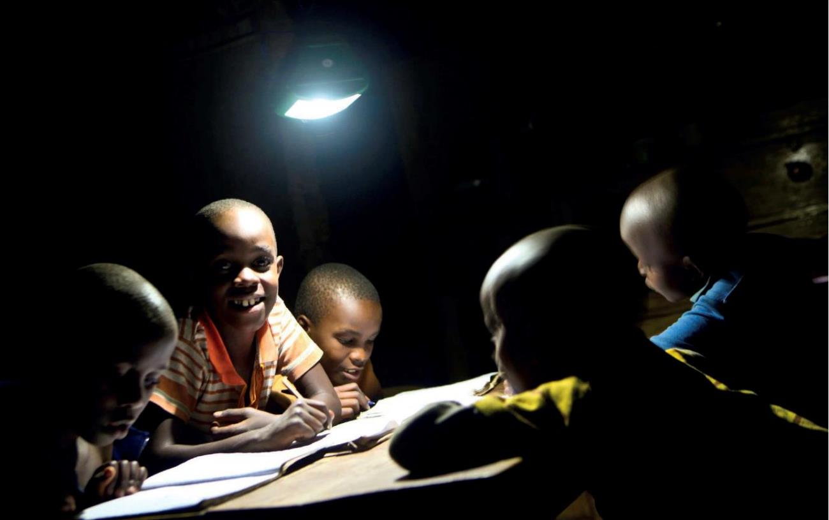
Notes:
Lesson 2, Step 2: problems from lacking electricity
Notes: Lacking access to electricity makes it difficult to do schoolwork in the evenings
Credit: Kevin Bailey
Source: Gambia Intouch

Slide 8
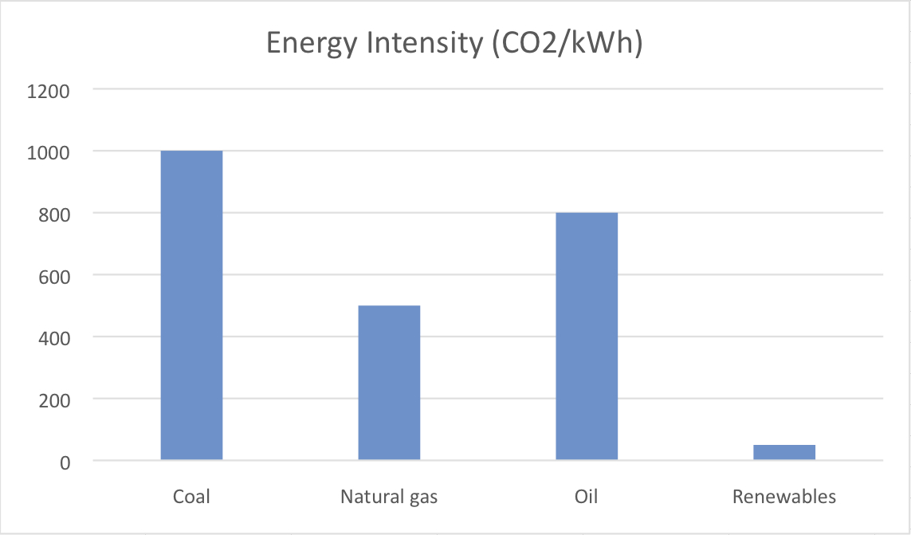
Notes:
Lesson 2,Step 3
Source: IPCC
Available at: https://www.ipcc.ch/pdf/special-reports/srren/SRREN_FD_SPM_final.pdf
Note: how much CO2 is produced per unit of energy from different sources

Slide 9
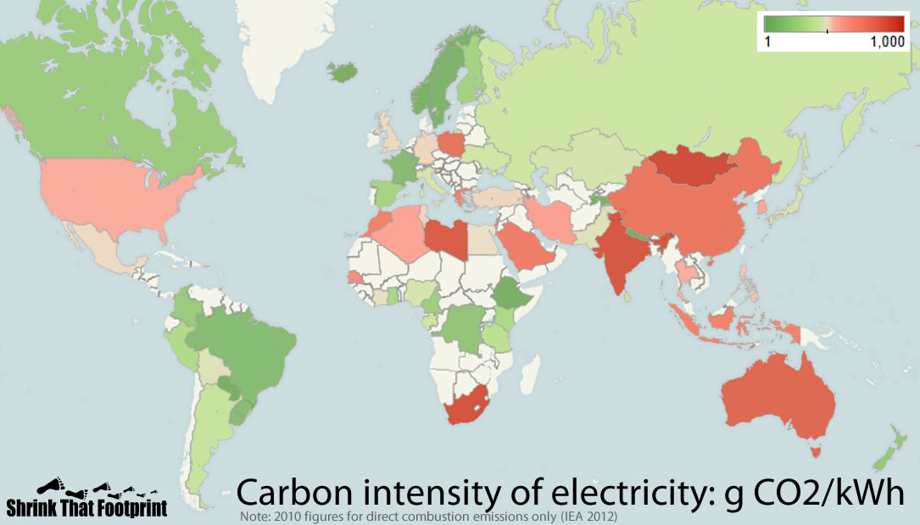
Carbon intensity
Notes:
Lesson 2, Step 3
Photo credit: Shrink That Footprint
Source: https://cleantechnica.com/2013/06/20/electricity-emissions-around-the-world-maps/
Note: 2010 figures for direct combustion emission only (IEA 2010)

Slide 10
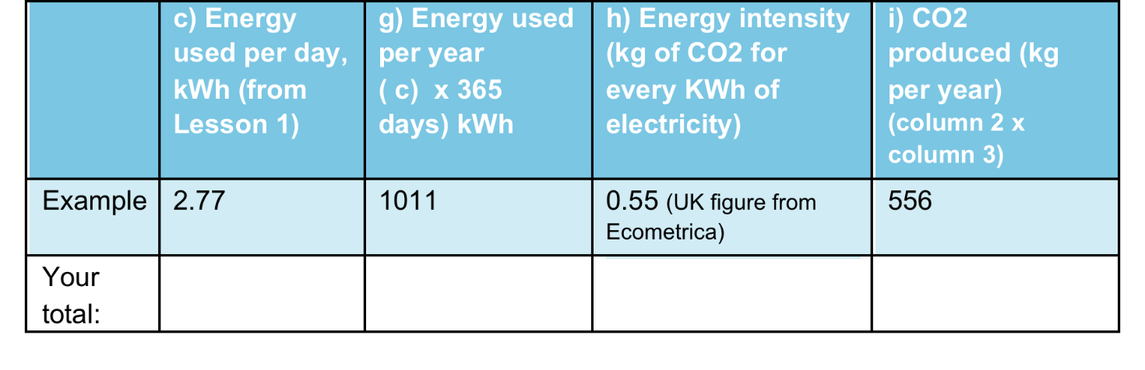
How much CO2 is produced from the electricity you use?
Notes:
Lesson 2
Step 3

Slide 11
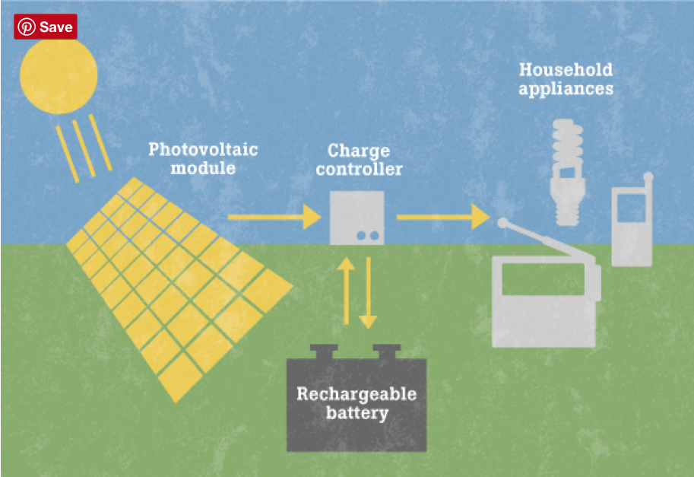
How solar home systems and solar lamps work
Notes:
Lesson 3, Step 2
Source: Ashden
Available at: to www.ashden.org

Slide 12
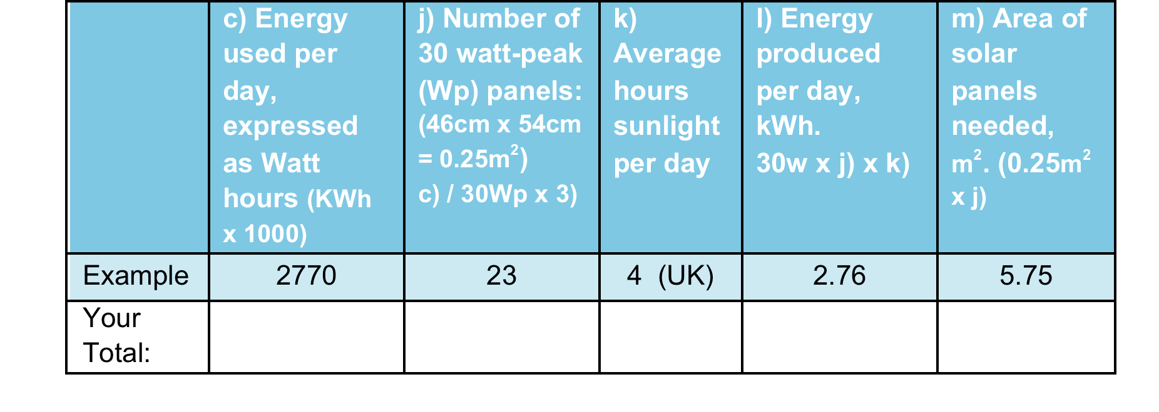
What area of solar panels would you need?
Notes:
Lesson 3,
Step 3

Slide 13
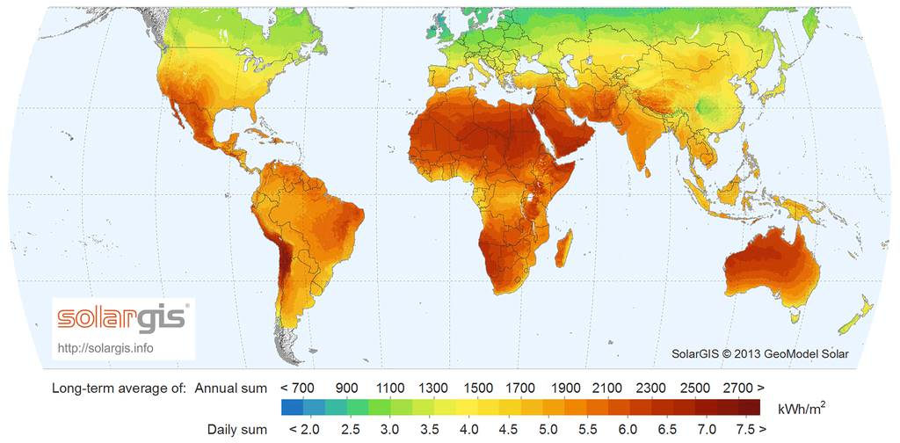
Hours of sunshine across the world
Notes:
Lesson 3 Step 3
Source: Solargis
Available at: http://solargis.com/products/maps-and-gis-data/free/download/world

Slide 14
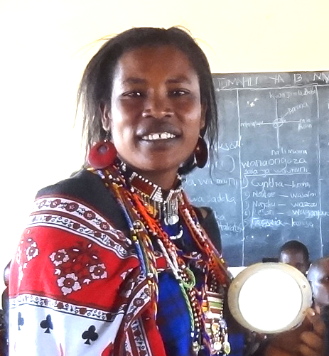
Isele tankile demonstrating a solar lamp in a school in rural Kenya
Notes:
Lesson 4. Case study from Appendix 5
Photo credit: Isele Tankile © Intoafrica

Slide 15
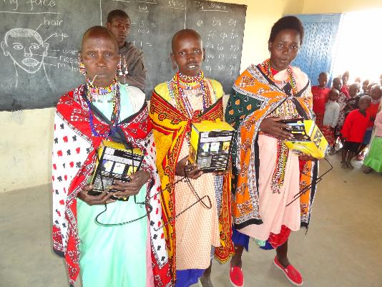
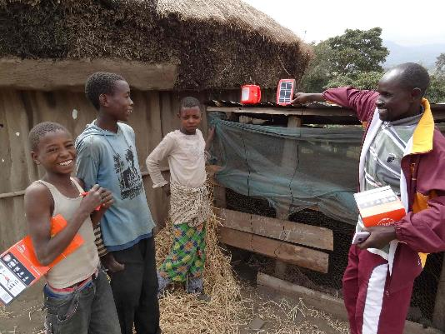
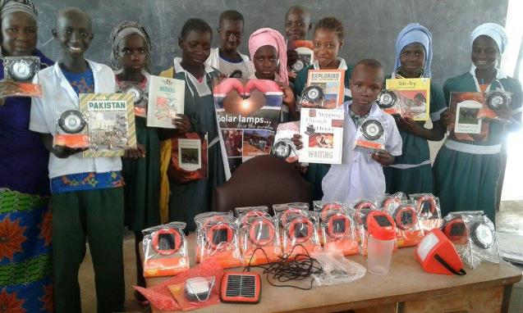
Solar devices in use
Alton Maasai, Kenya © Intoafrica
Rural village in Tanzania © Intoafrica, Kenya
Jan Jan Bureh, the Gambia
© Gambia Intouch
Notes:
Lesson 4, Step 3
Appendix 6

Slide 16
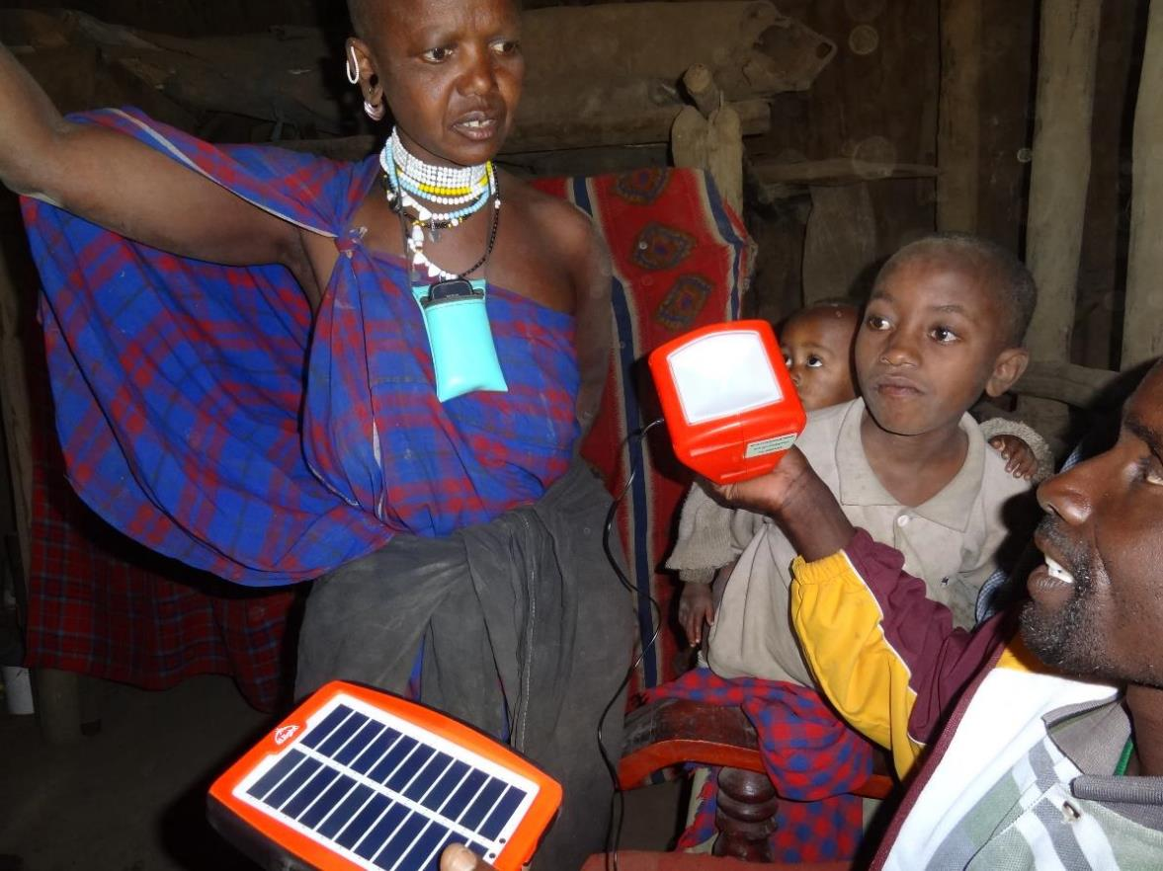
Notes:
Lesson 4. Step 5
Appendix 8
Alton Maasai, Kenya © Intoafrica

Slide 17
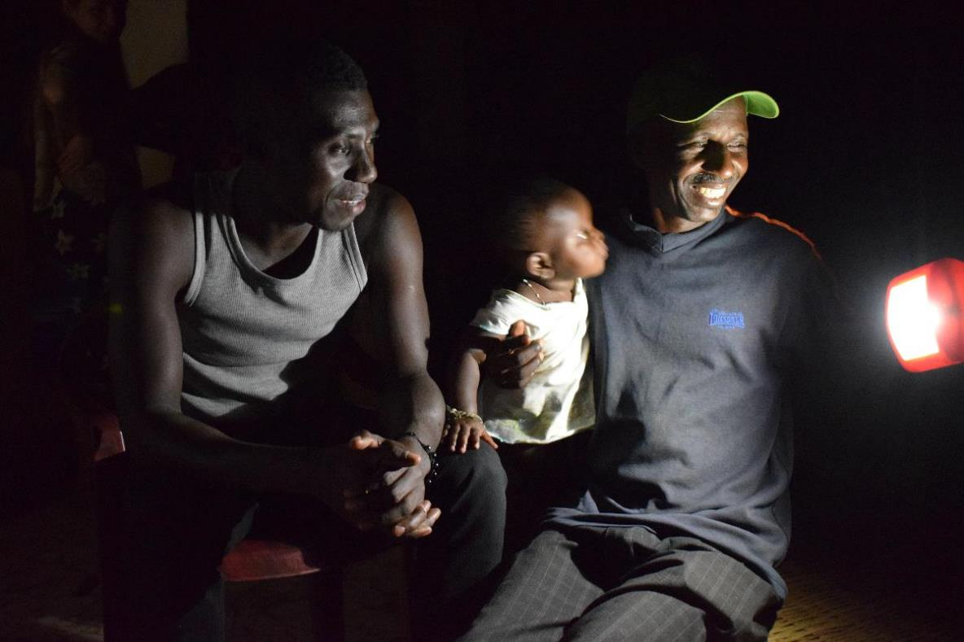
Notes:
Lesson 4. Step 5
Appendix 7
© Gambia Intouch

Slide 18
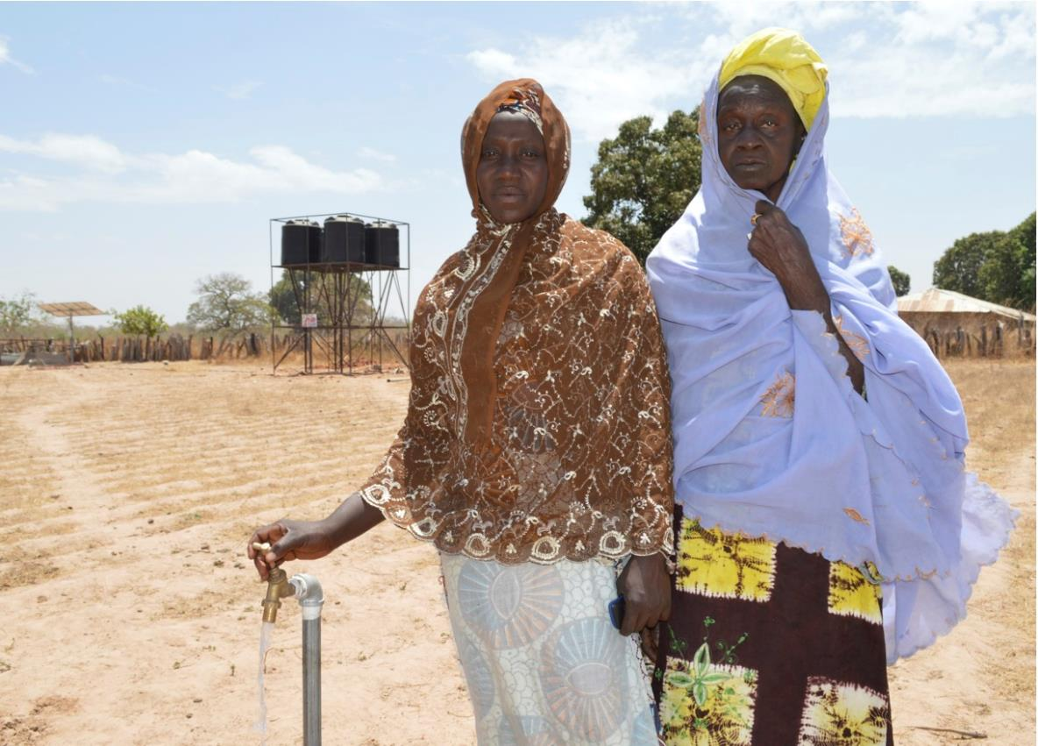
Notes:
Lesson 4 Step 5
Appendix 8
Project Gambia

Slide 19
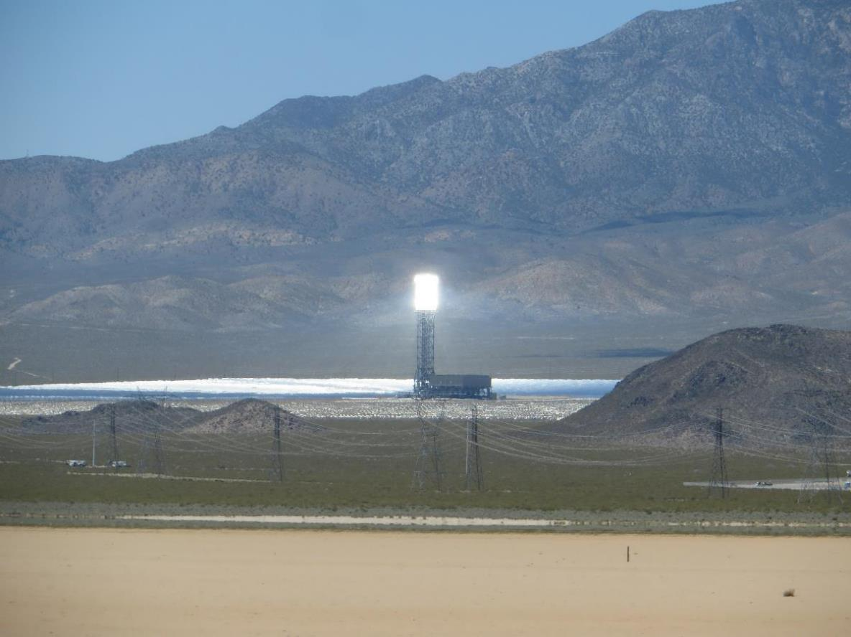
Notes:
Lesson 5
Credit: Flickr/Ken Lund (CC BY-SA 2.0)
Source: https://www.flickr.com/photos/kenlund/17172109047
Ivanpah Solar Electric Generating System, California

