Slide 1
These slides have been produced to support the
Climate change and girls’ education learning unit.
They can only be used with the main resource, which includes full instructions on how to use them with your class and a partner school.

Slide 2
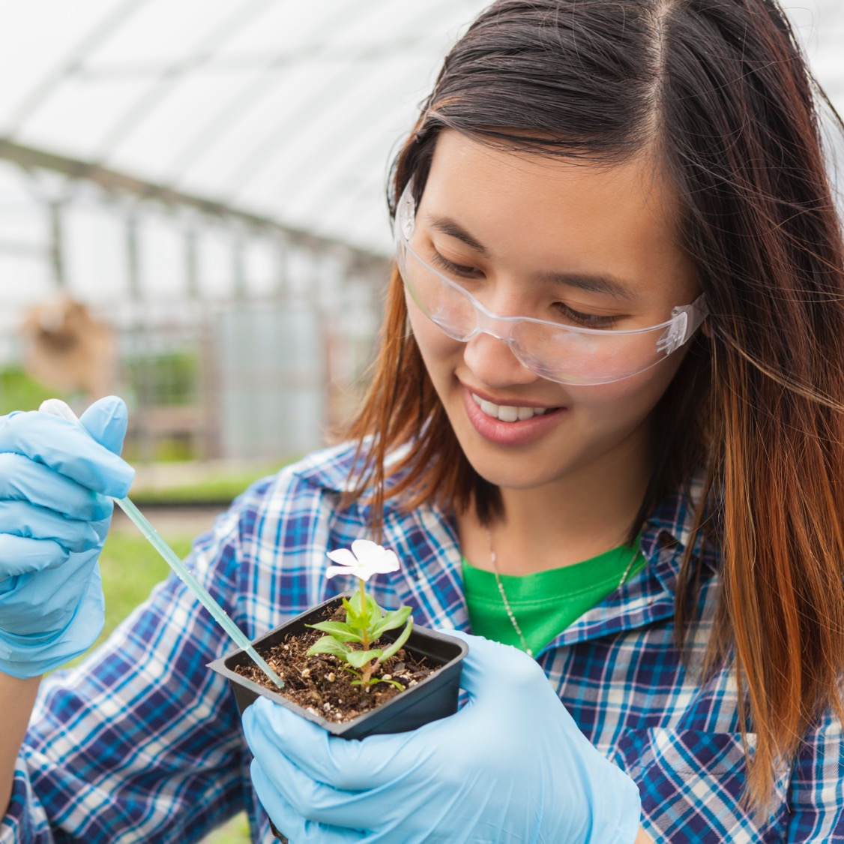

Funded by
The Climate Connection
Climate change and girls’ education:
school resource pack
www.britishcouncil.org/connectingclassrooms
Notes:
Branding to be updated.

Slide 3
Contents
Title | Slide | Title | Slide
What is climate change? | 4 | Gender scenarios | 18
How has the climate changed near you? | 5 | Gender inequality | 19
Risk of harm | 6 | Issues resulting from disasters and crises | 20
The Children’s Climate Risk Index | 7 | Girls’ education | 21
How to save our planet | 8 | Gender inequality and climate change | 22
Climate change solutions simulator | 9 | Women’s leadership and climate change | 23
Climate justice | 10 | Exploiting people and planet | 24
Climate change: Who is most responsible? | 11 | Key areas for girls’ education | 25
A) The top 20 highest emitters | 12 | Youth activist videos | 26
B) Highest CO₂ polluters per capita | 13 | Skills for green jobs | 27
C) Where CO₂ emissions have come from since 1751 | 14 | Whole-school approach | 28
D) Correlation between GDP/head and CO₂ emissions | 15 | Behavioural or system change? | 29
E) Percentage of C0₂ emissions by world population | 16 | Role-play scenario | 30
Equality, equity and liberation (justice) | 17

Slide 4
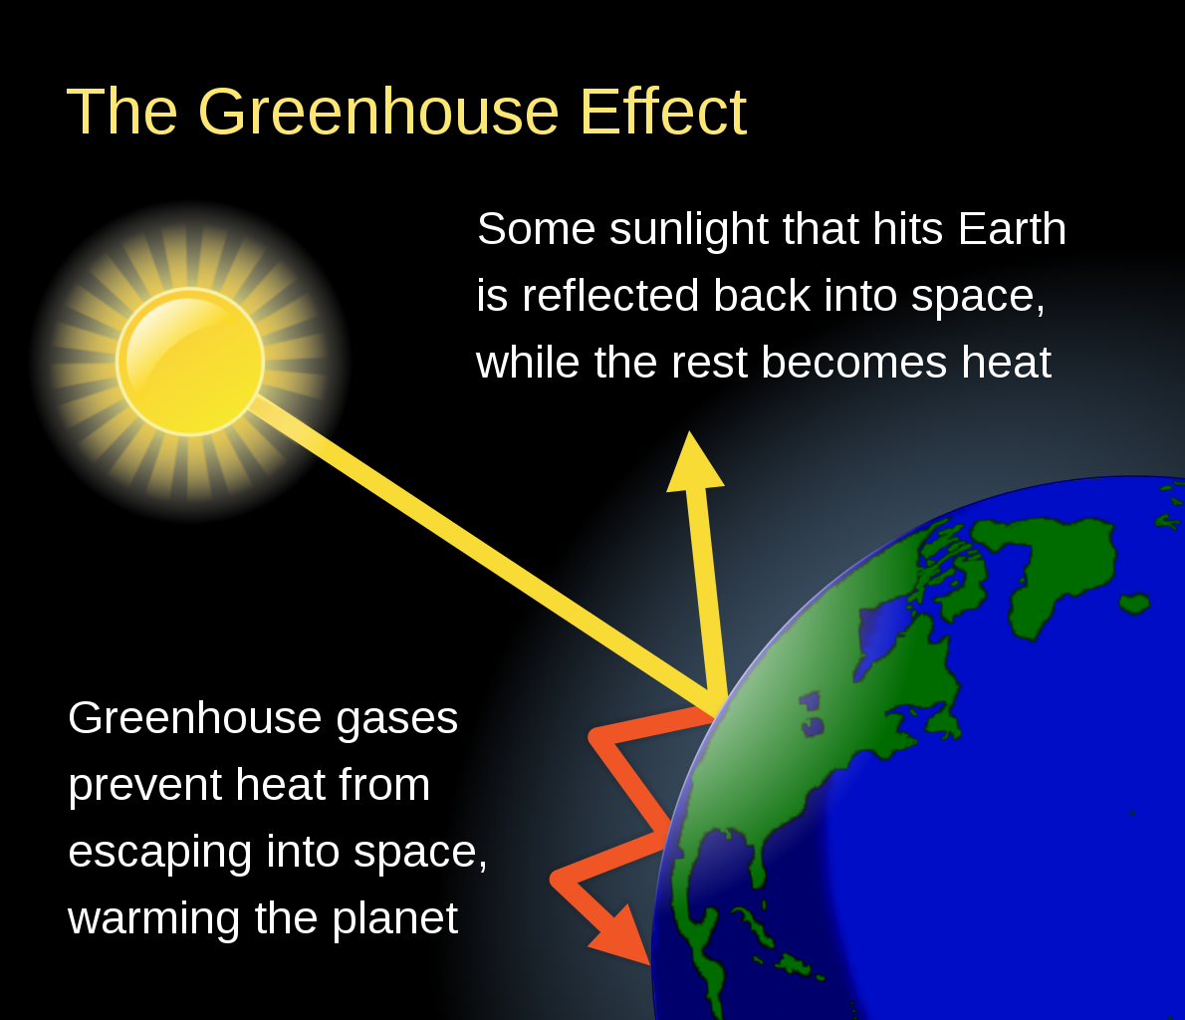
What is climate change?
Climate Change 2021 The Physical Science Basis
(8 mins 40 secs) IPCC
https://www.youtube.com/watch?v=e7xW1MfXjLA&t=532s
Notes:
Climate Change Schematic Efbrazil. CC SA 4.0
https://www.youtube.com/watch?v=e7xW1MfXjLA&t=532s
Climate Change 2021 The Physical Science Basis IPCC 6th Assessment Report
(8 mins 40 secs, without credits)
Alternative, more UK-focused video:
Climate Change, How fast is the world warming?
https://youtu.be/vMDeHUiqPZw
© British Crown copyright 2021, The Met Office
Licence page: https://www.metoffice.gov.uk/about-us/legal/registered-content
iprmanager@metoffice.gov.uk.

Slide 5
How has the climate changed near you?
Ask older family members to help you complete the table.
What | 20 years ago or more | Now
Extreme temperatures (very cold or very hot)
Extreme rainfall
Flooding
Severe storms
Notes:
Table derived from Chauhan, Dharmistha (2021). Training manual on gender and climate change resilience. Kuala Lumpur and Bangkok: The Asian-Pacific Resource and Research Centre for Women (ARROW) and UN Women Regional Office for Asia and the Pacific. https://www2.unwomen.org/-/media/images/unwomen/emp/attachments/2021/06/empower%20training%20manualgccrcompress.pdf?la=en&vs=4900&ct=t(EMAIL_CAMPAIGN_7_14_2021_12_20)

Slide 6
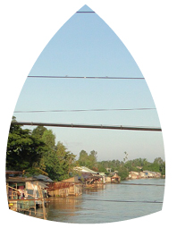
Risk of harm
Exposure
Risk
of harm
Hazard
Vulnerability
Notes:
Diagram derived from Chauhan, Dharmistha (2021). Training manual on gender and climate change resilience. Kuala Lumpur and Bangkok: The Asian-Pacific Resource and Research Centre for Women (ARROW) and UN Women Regional Office for Asia and the Pacific. https://www2.unwomen.org/-/media/images/unwomen/emp/attachments/2021/06/empower%20training%20manualgccrcompress.pdf?la=en&vs=4900&ct=t(EMAIL_CAMPAIGN_7_14_2021_12_20)
Photograph: Vietnam flooding 2011 Water levels have been rising rapidly throughout the Mekong delta
https://www.flickr.com/photos/eu_echo/6975580399
Photo credit: Evangelos Petratos EU/ECHO
Location: Hong Ngu township, Dong Thap province
CC BY-SA 2.0

Slide 7
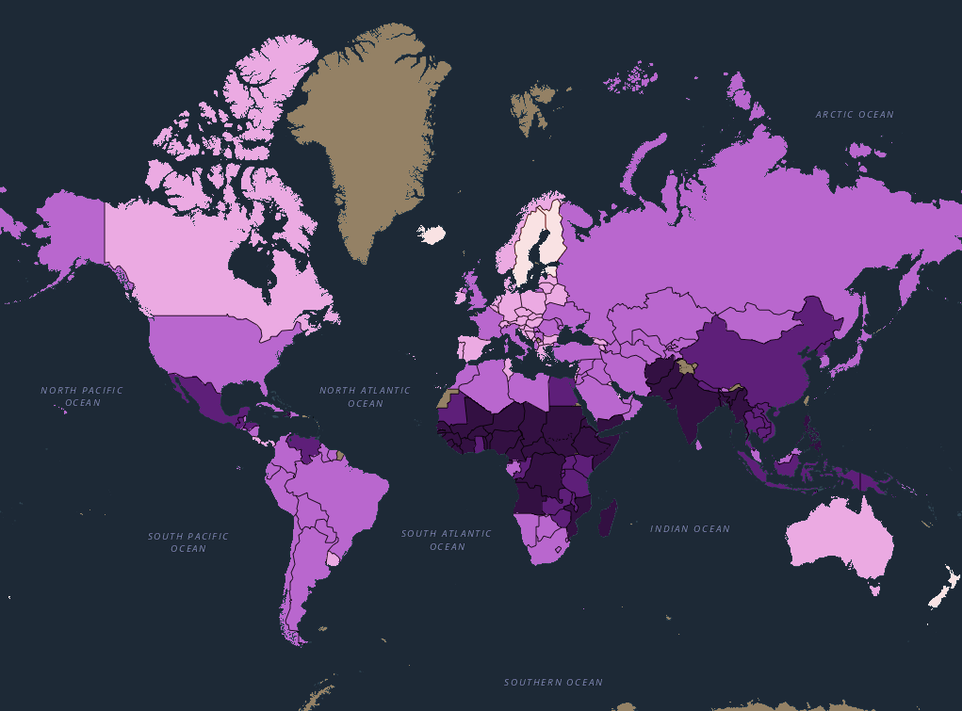
The Children’s Climate Risk Index
The darker the colour, the higher the risk of children being affected by climate change.
Link to interactive map
What patterns do you notice?
Which parts of the world are most at risk?
What is the situation like for your country?
Notes:
The Children’s Climate Risk Index (CCRI)
https://experience.arcgis.com/experience/0d9d2209bf104584a65e012b03b6d3f8/
(Best viewed on Google Chrome)
Except where otherwise noted, content on this site, including the interactive map, is licensed under a Creative Commons Attribution-NonCommercial 3.0 IGO license.

Slide 8


How to save our planet
https://www.ourplanet.com/en/
(© WWF, Netflix and Silverback Films 8 mins 27 secs)
Notes:
How to save our planet: https://www.ourplanet.com/en/ or https://www.youtube.com/watch?v=0Puv0Pss33M
A Netflix original documentary series and groundbreaking collaboration between WWF, Netflix and Silverback Films, Our Planet showcases the world's natural wonders, iconic species and wildlife spectacles that still remain. We're all a part of this amazing planet, but we're changing it like never before. Discover the story of the one place we all call home. Watch Our Planet on Netflix: https://www.netflix.com/ourplanet Explore: www.ourplanet.com

Slide 9
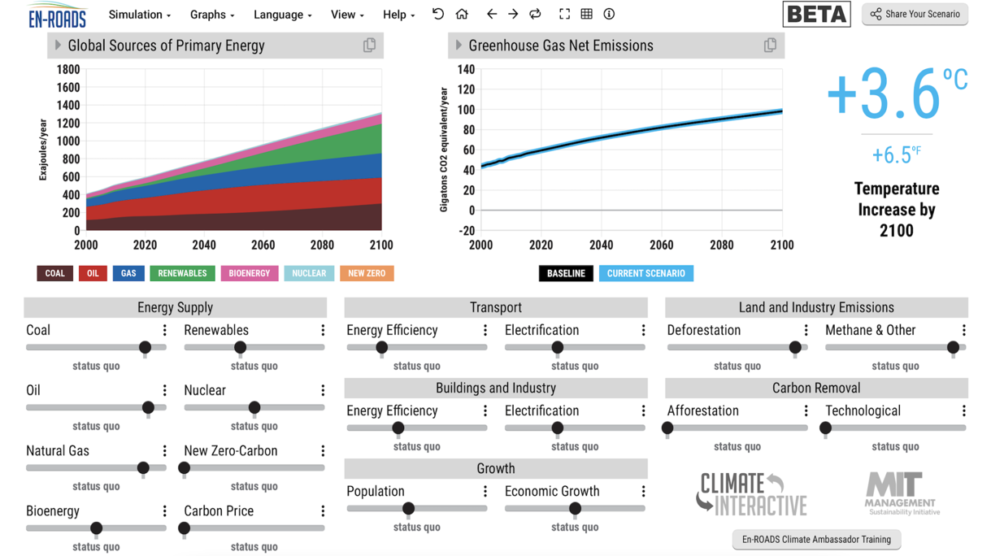
Climate change solutions simulator
Click on the website link, go to ‘The EN-Roads simulator’, move the sliders and watch the effects on CO₂ emissions. Go to the ‘Help’ menu and select ‘Related Examples’ to understand the sliders better.
https://www.climateinteractive.org/
Notes:
Step 1 Part 3 extension activity
Climate solutions: Full link: https://en-roads.climateinteractive.org/scenario.html?v=21.12.0

Slide 10

Climate Justice
Climate justice links human rights and development to achieve a human-centred approach, safeguarding the rights of the most vulnerable people and sharing the burdens and benefits of climate change and its impacts equitably and fairly.
Those who have most responsibility for greenhouse gas emissions and most capacity to act must cut emissions first. Those who have benefited and still benefit from emissions in the form of on-going economic development and increased wealth, mainly in industrialised countries, have an ethical obligation to share benefits with those who are today suffering from the effects of these emissions, mainly vulnerable people in developing countries.
Notes:
https://www.mrfcj.org/principles-of-climate-justice/ © 2022 Mary Robinson Foundation – Climate Justice

Slide 11

Climate change – who is most responsible?
Read through the arguments and look at the slides of the graphs.
Decide on your position on the agree/disagree line for each argument and record your answer.
Look through your answers again at the end and adjust them if you need to.
Read the interpretations on the activity sheet.
Disagree
Unsure
Agree
Notes:
See Step 2 activity sheet
Note: the Global Carbon Atlas (http://www.globalcarbonatlas.org/en/CO2-emissions) has more recent data on the top 20 emitters (for Graph A)
Pupils should check their answers. If they agree with: 1, 2, 4 and 6 and disagree with 3, 5, 7 and 8, they are likely to be aligned with Global North negotiators (e.g. USA and Europe).
If they agree with 3, 5, 7 and 8 and disagree with: 1, 2, 4 and 6, they are likely to be aligned with Global South negotiators (e.g. nations of South Asia or Africa) though some may also agree with 1).
Differing positions are a key obstacle in preventing countries of the world from agreeing on stronger action to tackle climate change and its effects.

Slide 12
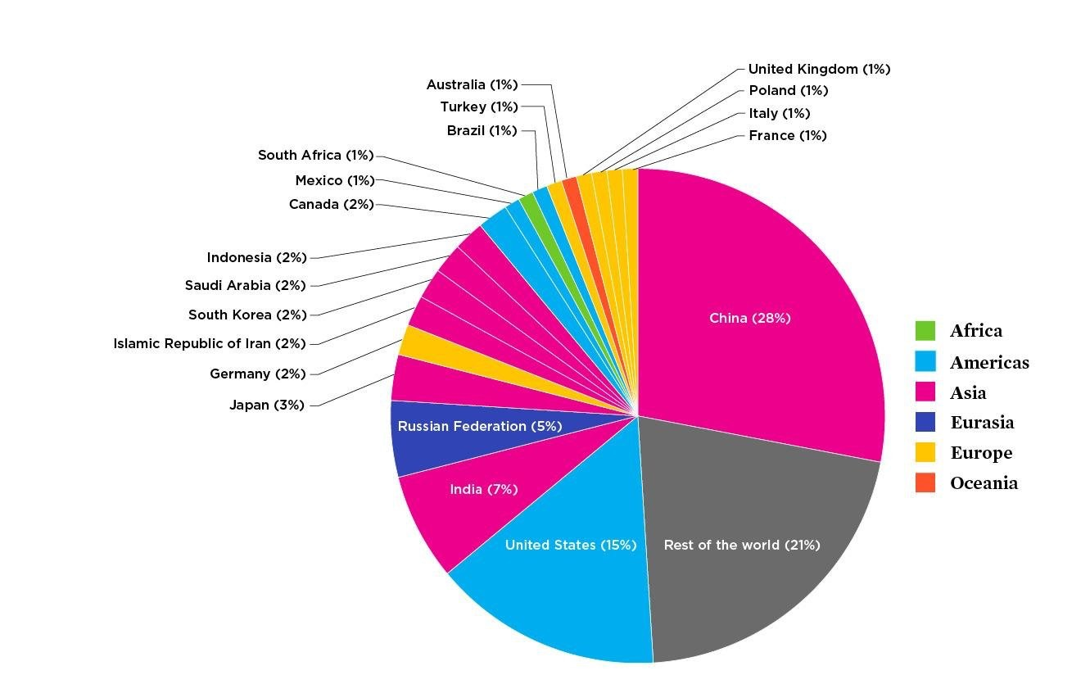
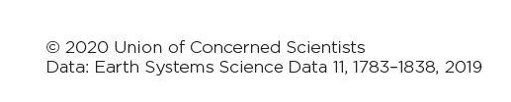
The top 20 highest emitters of annual
carbon dioxide
in 2018
Notes:
Source: https://www.ucsusa.org/resources/each-countrys-share-co2-emissions

Slide 13
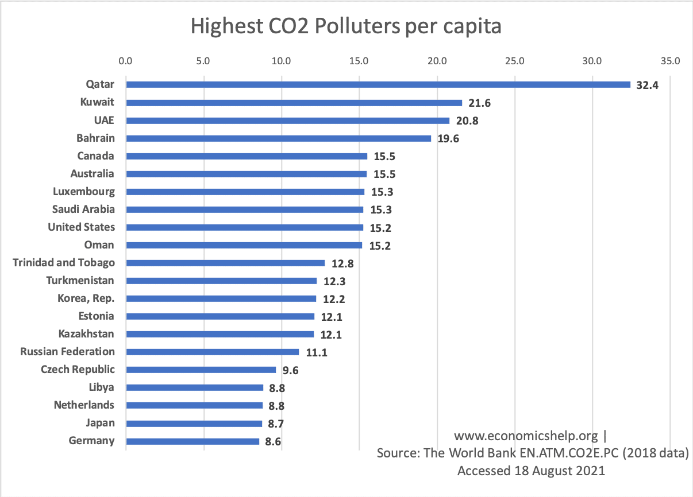
B)
B) Highest CO₂ polluters per capita
Notes:
Source: https://www.economicshelp.org/blog/10296/economics/top-co2-polluters-highest-per-capita/ used with kind permission.

Slide 14
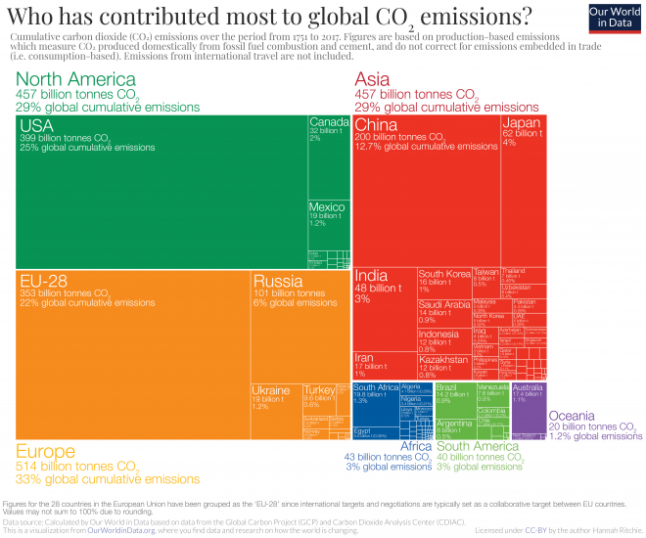
C) Where CO₂ emissions have come from since 1751.
Notes:
Source: https://ourworldindata.org/contributed-most-global-co2. Hannah Ritchie/OurWorldinData.org CC-BY 4.0

Slide 15
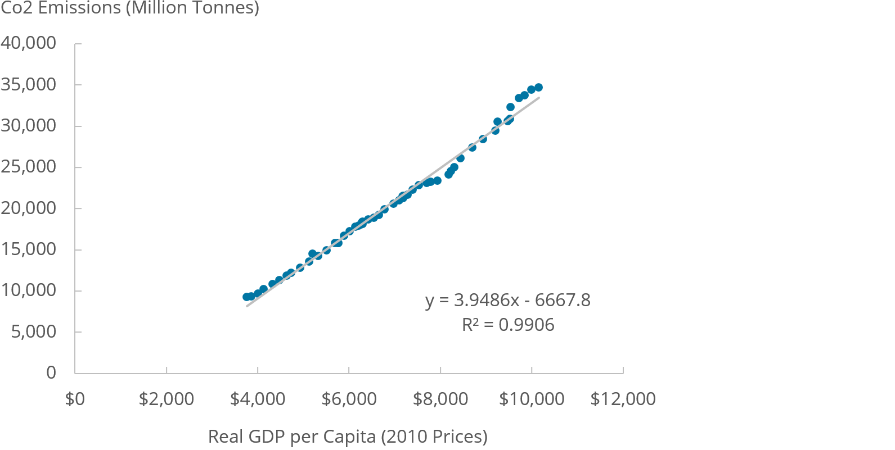
D) There is a strong correlation between real GDP per head (a measure of a
country’s wealth) and CO₂ emissions (tonnes) globally, 1960 to 2014
Notes:
Source: https://www.ons.gov.uk/economy/nationalaccounts/uksectoraccounts/compendium/economicreview/october2019/thedecouplingofeconomicgrowthfromcarbonemissionsukevidence World Bank, 2019 and World Resources Institute, 2017 OGL

Slide 16
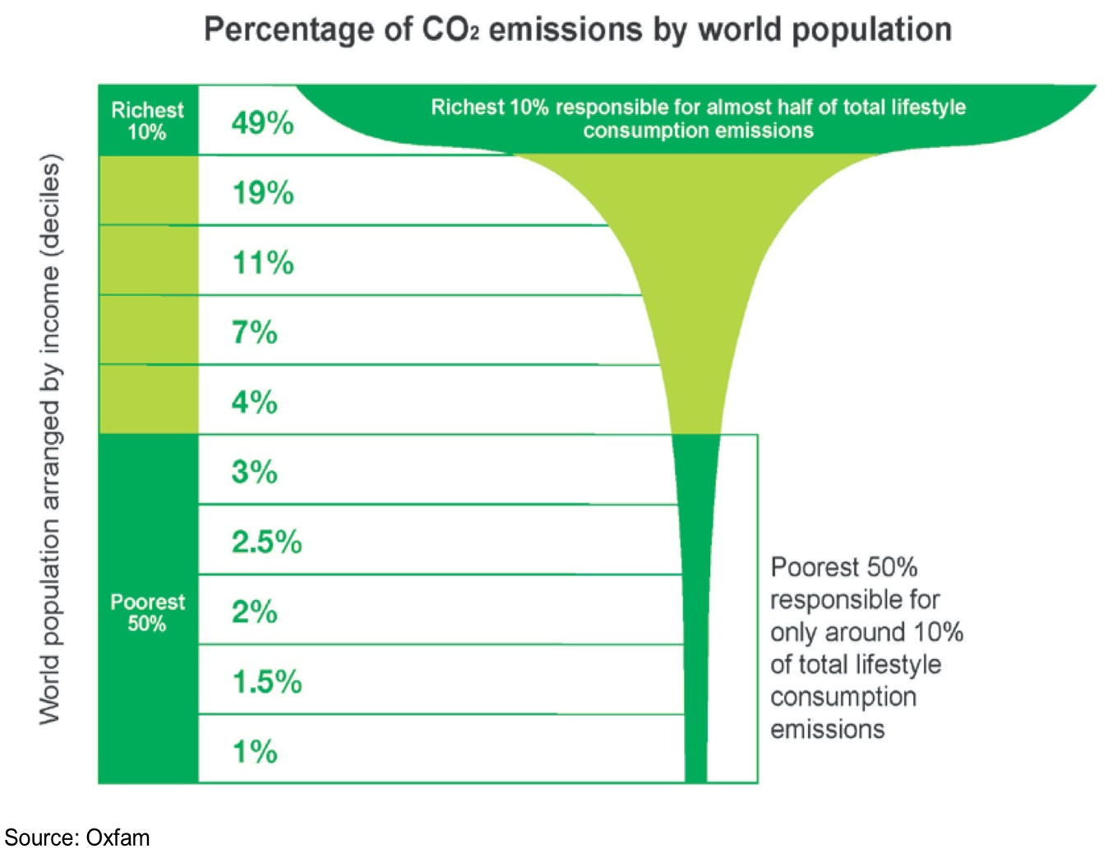
E) Percentage of CO₂ emissions by world population
Notes:
Climate change negotiations happen between countries but the richest 10 per cent of the world’s people emit almost half of the total CO₂ emissions relating to lifestyles. Should this be taken into account? If so, how?
Global income deciles and associated lifestyle consumption emissions Extreme Carbon Inequality Gore, T (2015) Oxfam
https://oxfamilibrary.openrepository.com/bitstream/handle/10546/582545/mb-extreme-carbon-inequality-021215-en.pdf?sequence=9

Slide 17
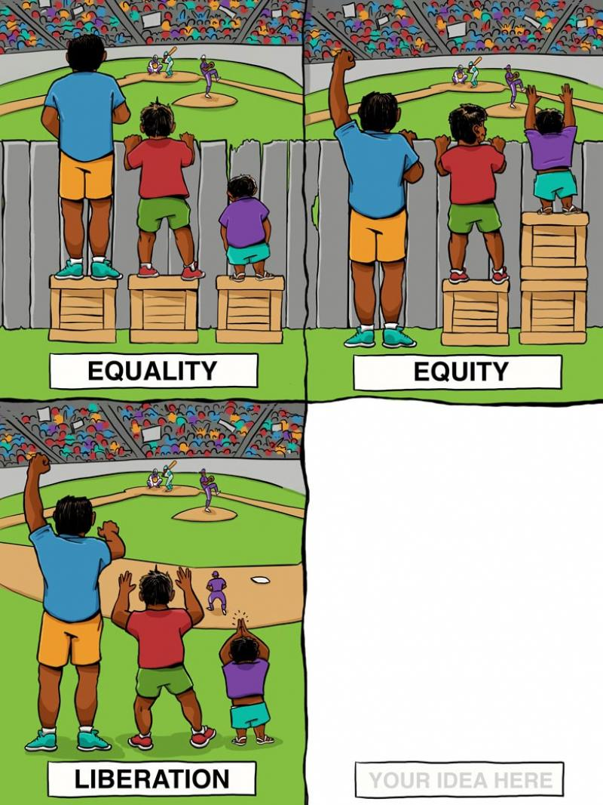
Title?
Interaction Institute for Social Change | Artist: Angus Maguire
Notes:
Source: Interaction Institute for Social Change | Artist: Angus Maguire.
https://blogs.tip.duke.edu/teachersworkshop/equity-vs-equality-vs-liberation-first-steps-toward-inclusive-classroom-discussions-with-gifted-youth/
Fair Use Section 107 of Chapter 1 of Title 17 of the US Code

Slide 18
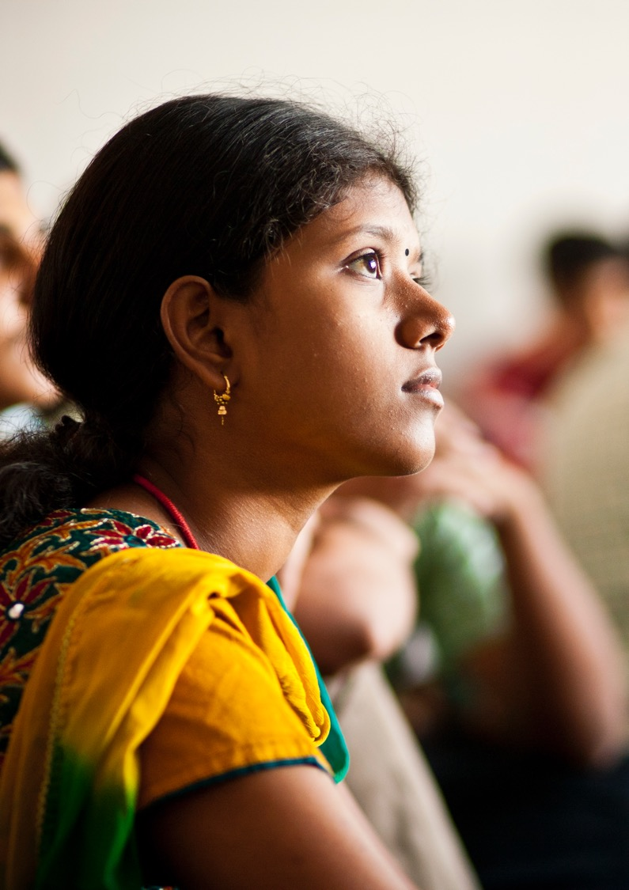
Gender scenarios
A: The eldest daughter in the family wants to go to secondary school. She is very good at maths. Her parents say they do not think they can afford to send both her and her younger brother to secondary school. Her mother needs help looking after her youngest brother and with domestic work.
B: A teenage girl in a rural community wants to set up a girls’ club to make a drought resistant water irrigation system to support local farmers. It will help crops survive in the drier conditions brought about by climate change. The local council is blocking approval for these systems to be set up as they do not think the girls have the skills to do this.

Slide 19
Power relations
Gender roles
Social norms
Gender inequality
Notes:
Social norms (accepted behaviours amongst groups of people) may reflect, allow or lead to imbalances of power relations between boys and girls (where children’s rights, like the right to education, are not accessed equally). Social norms may also support stereotypical gender roles (like childcare) that reinforce power imbalances and result in gender inequality, unless such norms are revealed and challenged.
Griffin, H. (2018) Gender Equality in Primary Schools London: Jessica Kingsley Publishers p. 15

Slide 20
Issues resulting from disasters and crises
Issue | Who is most affected? |  |  | Reason?
 | Boys | Girls | Both | –––––––––
Malnutrition due to a family’s loss of food crops or income
Illness from infectious diseases due to unhygienic conditions and lack of safe drinking water
Increased domestic and care work for other family members
Being taken out of school due to lack of funds
Increased pressure to help earn an income to support the family
Being married at an early age (to save money and for dowry)
Migration to another country, living in temporary shelter
Increase in gender-based violence or sexual harassment
Parental stress, anxiety and mental health problems
Having to travel further to get fuel or water as local sources damaged or contaminated

Slide 21


Girls’ education
Girls’ Education
Giving girls and boys equal access to education is one way to tackle
gender inequality.
Having an education, at least up until the end of secondary school,
enables girls to live healthier lives, make more of their own choices
and earn more income.
It also enables girls to decide when to marry (or not), and how many children to have and when. Those children are also likely to grow up healthier.
There is a lot of evidence that society as a whole benefits from girls’ education.
Yet, around the world, 129 million girls are out of school, including 32 million of primary school age, 30 million of lower-secondary school age,
and 67 million of upper-secondary school age (UNICEF 2021).
Why is this the case? What can be done about it?
Notes:
UNICEF 2021 https://www.unicef.org/education/girls-education

Slide 22


Gender inequality and climate change
A: Men accounted for 60 per cent of active speakers in the COP26 (international climate conference 2021) plenary and spoke for 74 per cent of the time.
B: 80 per cent of those displaced by climate-related disasters and changes around the world are women and girls.
C: Inequalities faced by girls can begin right at birth and follow them all their lives. In times of climate-related shocks, families may revert to gender norms and make decisions that harm girls, like pulling them out of school to marry them off early.
D: Only 29 per cent of green jobs globally are occupied by women. As countries move to focus on transitioning to green economies, women risk being left out of important jobs and opportunities.
Notes:
A: ODI 2021 https://odi.org/en/insights/our-thoughts-on-cop26-rolling-insight/
and She changes climate https://www.shechangesclimate.org/
B: UN 2021 https://news.un.org/en/story/2021/11/1105322
and Gender-Responsive Pedagogy: a toolkit for teachers and schools 2nd edition (2018). Forum for African Women Educationalists (FAWE), page 104 box on Gender and Disasters
C: UN 2020 https://www.un.org/sustainabledevelopment/wp-content/uploads/2016/08/5_Why-It-Matters-2020.pdf
D: Fortune 2021 https://fortune.com/2021/11/19/the-green-economy-is-poised-to-create-an-immense-amount-of-prosperity-women/

Slide 23

Women’s leadership and climate change
A 2019 study of 91countries found that those with more women in national parliaments had tougher climate change policies and so had lower carbon emissions. They were also more likely to have stronger environmental protection policies.
(Yale Climate Connections 2019)
Notes:
Yale Climate Connections 2019 https://yaleclimateconnections.org/2019/09/countries-with-more-female-politicians-pass-more-ambitious-climate-policies-study-suggests/
Original research Gender and climate change: Do female parliamentarians make difference? Astghik Mavisakalyan & Yashar Tarverdi European Journal of Political Economy Volume 56, January 2019, Pages 151–164

Slide 24


Exploiting people and planet
Many people are coming to the conclusion that one of the reasons why we are facing a climate and a nature emergency is that humans too often consider themselves above nature and that the planet is there for them to dominate and exploit. Many societies are also run by people who in a similar way dominate and exploit those who have less power, such as women and girls. Girls’ education and the achievement of gender equality can be important pathways to addressing the underlying drivers of climate change and the unique climate vulnerabilities borne by girls and women.
Girls’ education, particularly secondary education, has been identified as the most important socioeconomic determinant to reduce vulnerability to weather-related disasters and extreme weather. (Malala Fund 2021)
Notes:
Malala Fund 2021 A greener, fairer future: Why leaders need to invest in climate and girls’ education https://malala.org/newsroom/archive/malala-fund-publishes-report-on-climate-change-and-girls-education

Slide 25


Key areas for girls’ education
Empowerment
Giving girls (and women) greater access to family planning and health rights, enabling them to make more of their own choices.
Skills
Ensuring girls have access to quality education and can learn critical thinking, problem-solving, resilience and skills needed for adaptation to the green economy.
Leadership
Giving girls the confidence, skills and opportunities to participate in decision-making and play leadership roles in formal and non-formal spaces.
Notes:
Adapted from ‘Three platforms for girls’ education in climate strategies’ Christina Kwauk and Amanda Braga, Brookings Institute 2017 3 platforms for girls’ education in climate strategies (brookings.edu)

Slide 26
Youth activist videos
Mitzi Jonelle Tan, Youth Activists for Climate Action Philippines
https://www.youtube.com/watch?v=AyyUPr0plg8
Oli, campaigning against forced marriages in Bangladesh
https://www.youtube.com/watch?v=yvMQ90sCOGg
Gauri Shukla, Students of Singapore against Haze
https://www.connect4climate.org/event/innovate4climate-2019-digital-media-zone
(Day 2: June 5 – start one minute into the video)
Elizabeth Wathuti, Green Generation Initiative, Kenya
https://www.youtube.com/watch?v=N1iKg2Ug3Zk&t=45s
Helena Gualinga, indigenous activist, Sarayaku community, Ecuador
https://www.youtube.com/watch?v=a04JPKheFpw
Malala Yousafzai, Education activist and Nobel Peace Prize winner, Pakistan
https://www.youtube.com/watch?v=NIqOhxQ0-H8
Notes:
An accessible, illustrated book (for purchase) about other youth climate activists around the world can be found here:
https://www.birdgirluk.com/shop/

Slide 27
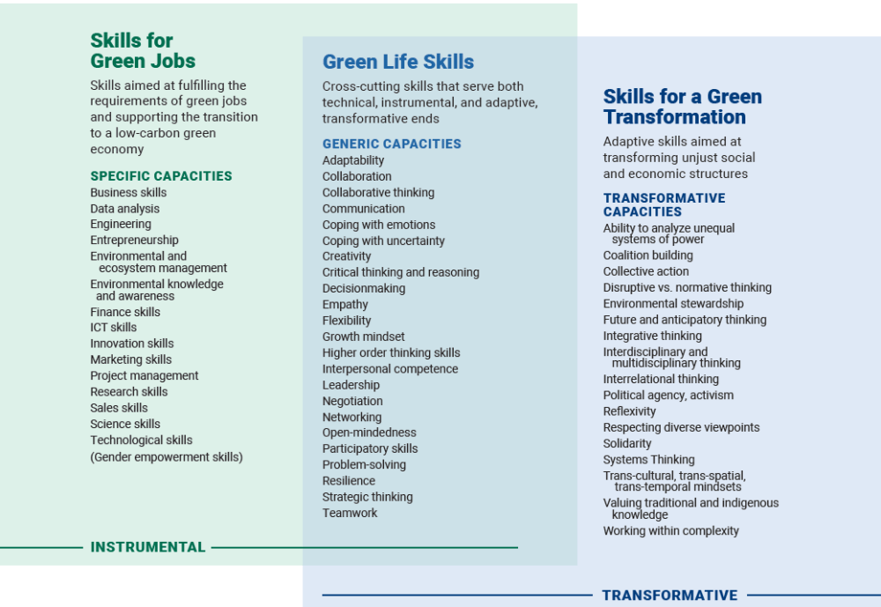
Notes:
Green skills framework https://www.brookings.edu/research/a-new-green-learning-agenda-approaches-to-quality-education-for-climate-action/

Slide 28

Whole-school
approach
Values
Equality for all
Care for oneself
Care for each other
Care for the planet
Your classroom
Your
school
Learning in and outside the classroom
Global understanding
Food and waste
Energy and water
Travel
School buildings and grounds
You
Your Community
Engaging with local community
Business links
Global links
Sharing learning
Adapted from Sustainable Schools
DCSF 2006
Notes:
Sustainable Schools https://webarchive.nationalarchives.gov.uk/ukgwa/20090608185221/http:/www.teachernet.gov.uk/sustainableschools/leadership/leadership_detail.cfm?id=3

Slide 29
Behaviour change or system change to tackle climate change? Sort and prioritise the statements.
Behaviour change | Both | System change
Notes:
See Step 5 activity sheet
a) reduce food waste
b) reduce single-use plastics
c) change lightbulbs to LED
d) improve public transportation
e) subsidise renewable energy
f) plant trees
g) become vegan
h) raise awareness about inequality,
i) re-wild land and sea areas
j) support girls’ completion of secondary education
Add your own ideas…

Slide 30
Role play scenario
There is a proposal to build a large coal mine in a green space in a rural area, dependent on agriculture, but badly affected by recent extreme weather conditions. Gender roles are traditional, with women as homemakers and men as main wage earners and decision-makers. The quality of education is poor; most girls leave school at 13 or 14, unable to read or do basic maths.
It will create a lot of jobs in an area with high unemployment and local poverty.
It will help to provide cheap and reliable energy.
The local secondary school will have to relocate to the next town, making pupils undertake a long daily journey.
The primary school is located so close to the mine that there will be a lot of noise and air pollution.
The mine will recruit many of the local men and boys who will not be available to work on their farms.
Pollution and nature loss will lead to less food being grown.
The local water supply may become polluted so fresh water would need to be fetched from further away.
A high number of male workers will move in from other towns.
There will be an increase in carbon emissions.
The opposition to the mine is being led by a local group ‘Mothers for the Future’.
Notes:
See Step 6 for a simple scenario for pupils and a more detailed scenario (for teachers).

