Slide 1
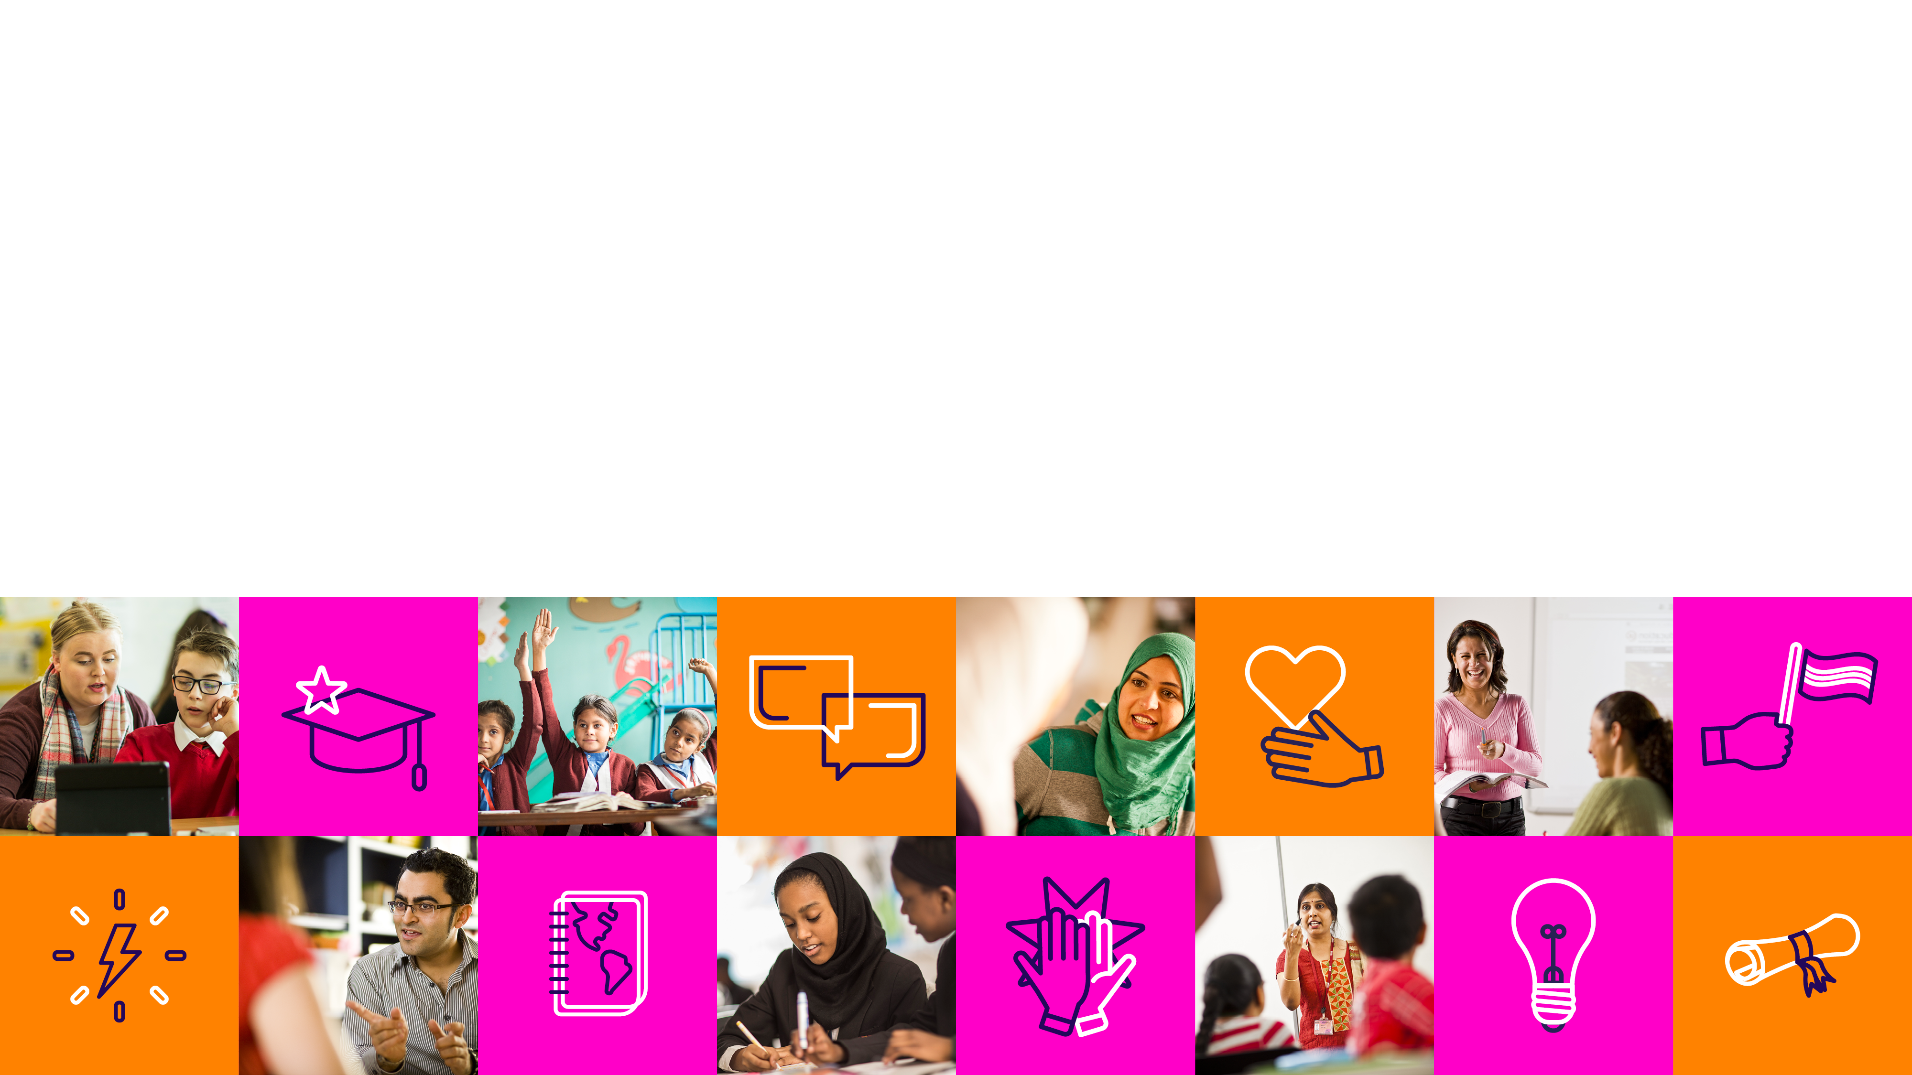
Gender Equality
Schools Connect
Gender equality through citizenship

Slide 2
These slides have been produced to support the Gender Equality learning unit.
They can only be used with the main resource, which includes full instructions on how to use them with your class and a partner school.

Slide 3
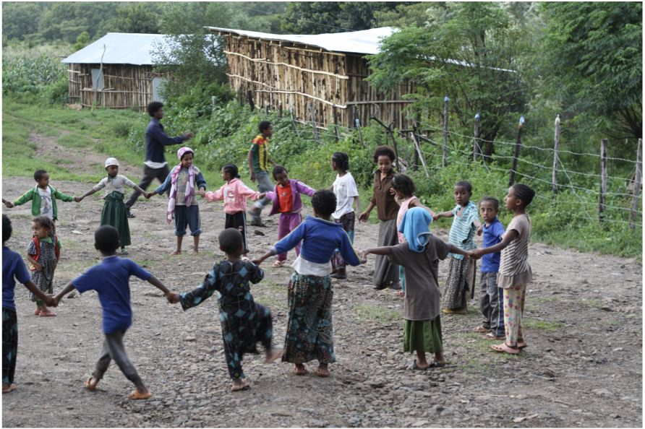
Lesson 5 Awra Amba

Slide 4
The bigger picture – visual activity

Slide 5
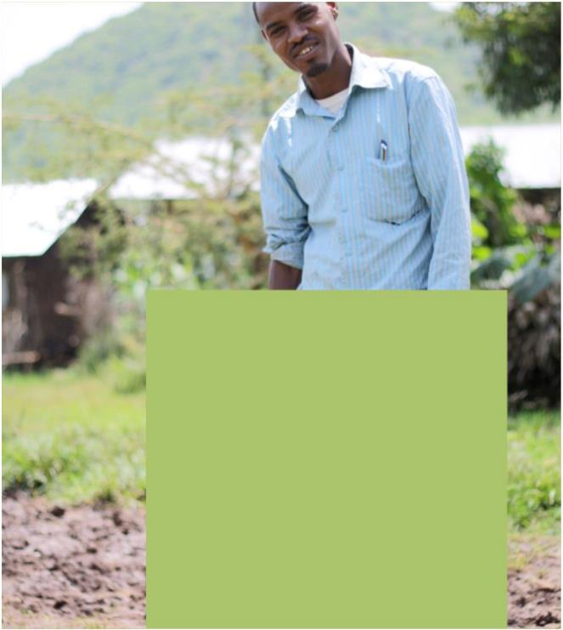
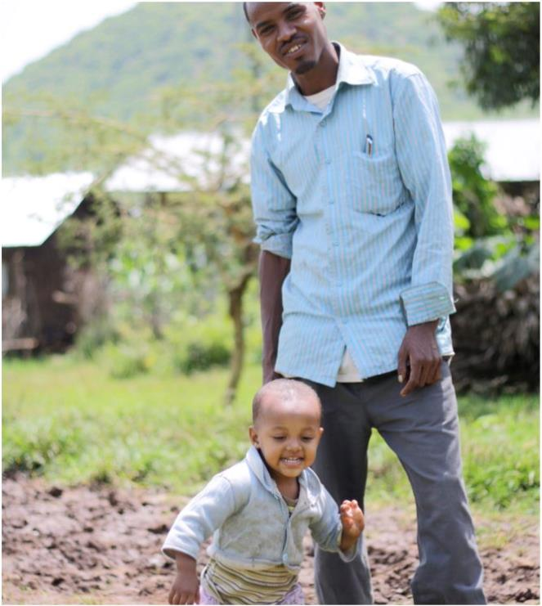
What do you see?

Slide 6
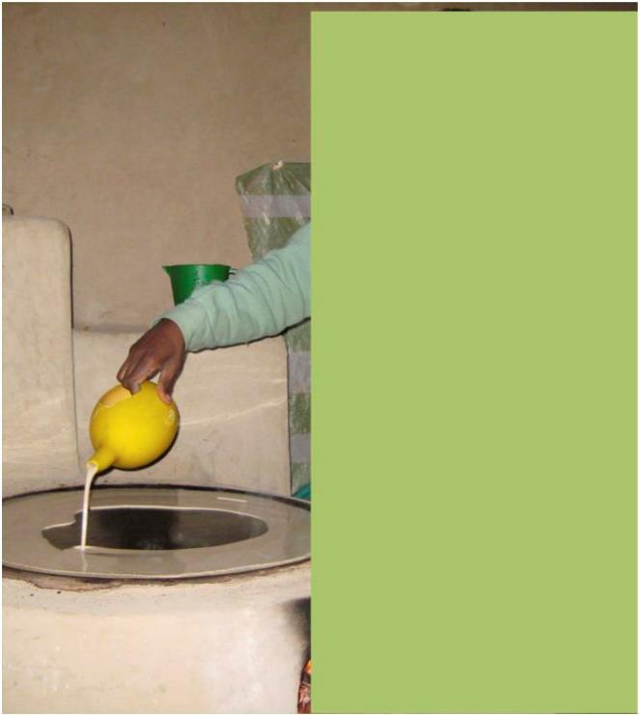
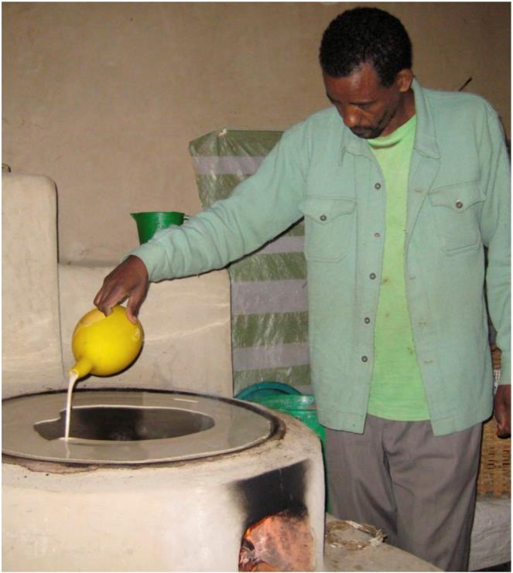
What do you see?

Slide 7
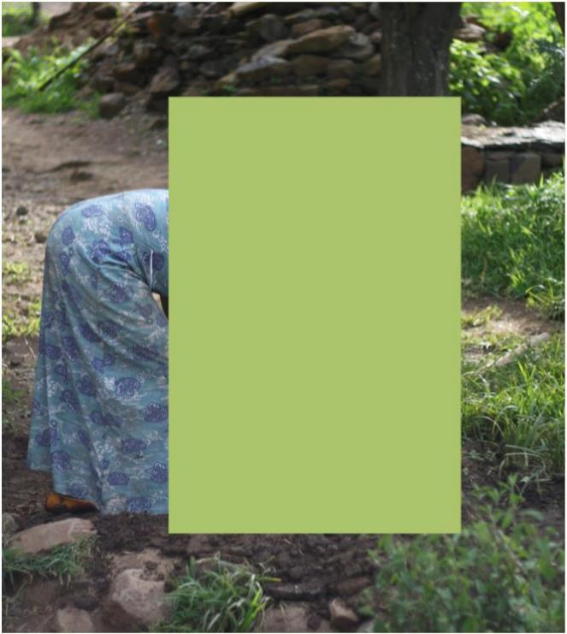
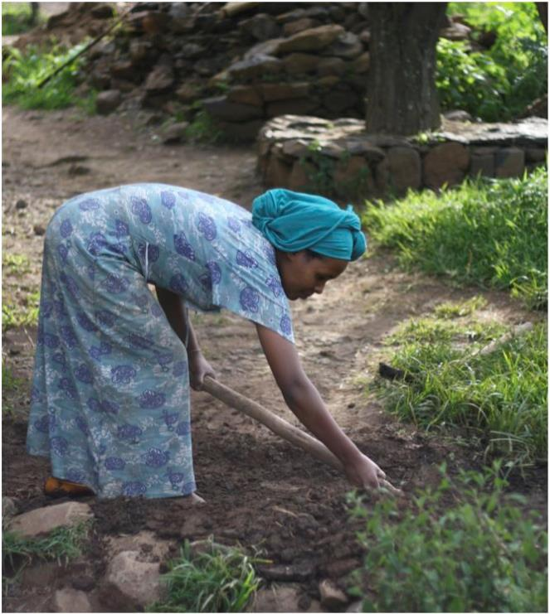
What do you see?

