Slide 1
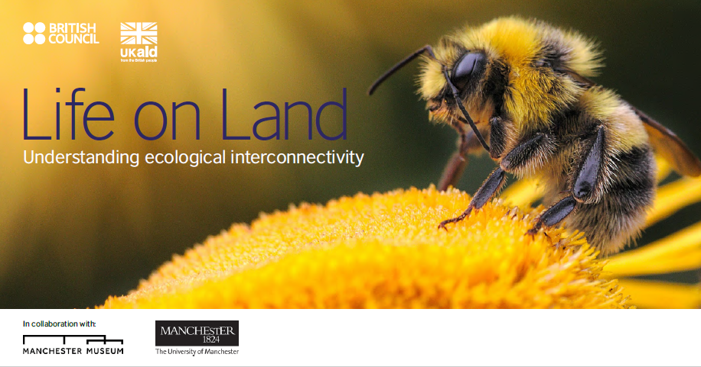
www.connecting-classrooms.britishcouncil.org/resources/global-learning-resources
Notes:
Image: Ales Krivec, Unsplash

Slide 2
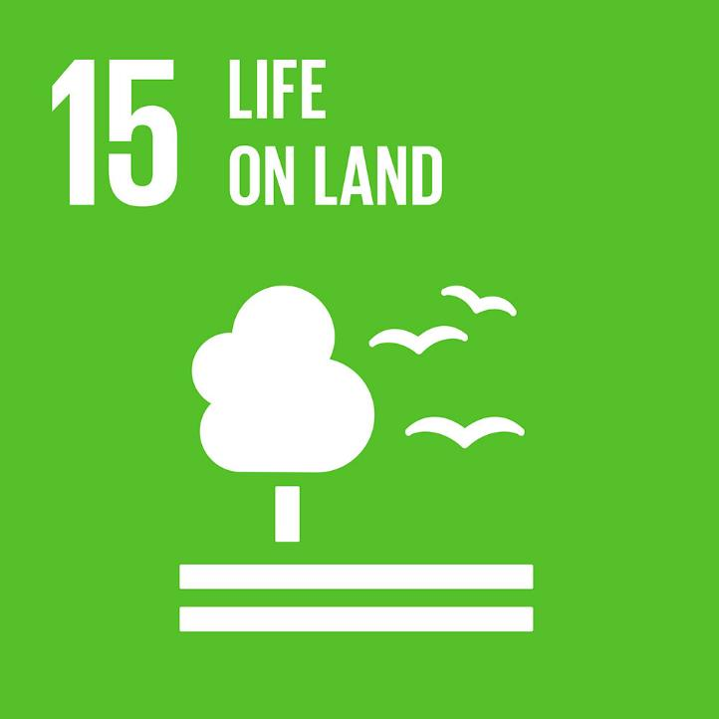
Lesson 1 Introduction

Slide 3











Notes:
YouTube video Link: https://www.youtube.com/watch?v=0XTBYMfZyrM – United Nations
Images: Unite Nations, Public Domain

Slide 4

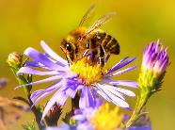
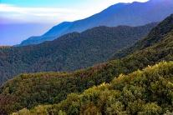
Goal 15: Life on Land
Life on land is incredibly diverse; scientists have estimated that there are over 11 million species on Earth! These species provide us with oxygen, pollinate our crops, produce our food, support our health and wellbeing and regulate our weather patterns.
But life on land is under increasing stress. Human activity has altered almost 75% of the Earth’s surface, impacting the habitats of animals and plants. Around 1 million animal and plant species are now threatened with extinction.
Notes:
Images left to right: Krzysztof Niewolny, Unsplash; Rohan Strestha, Unsplash

Slide 5
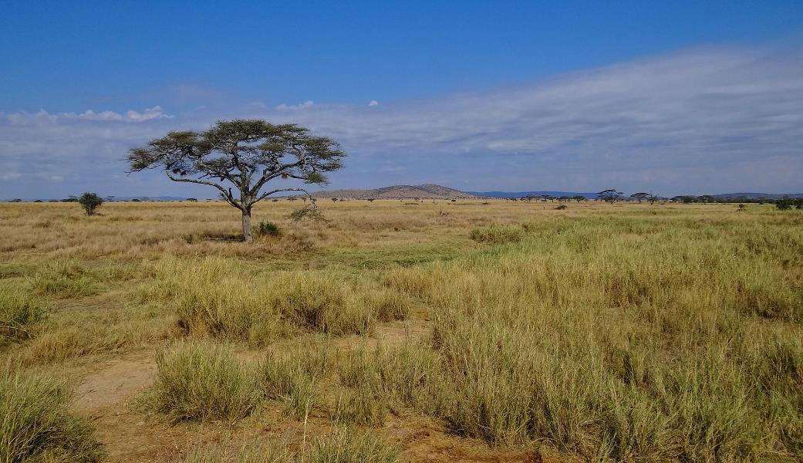
Savannah
Notes:
Image: Bjorn Christian Torrissen, Wikimedia Commons

Slide 6
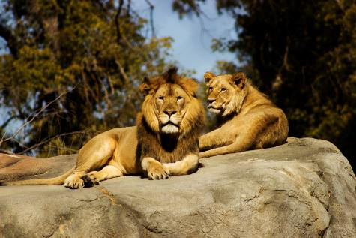
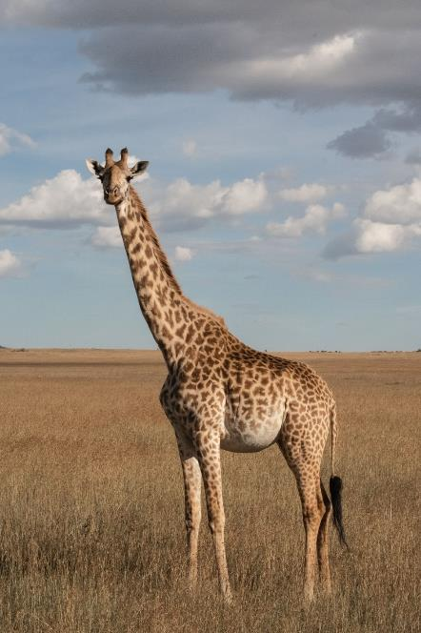
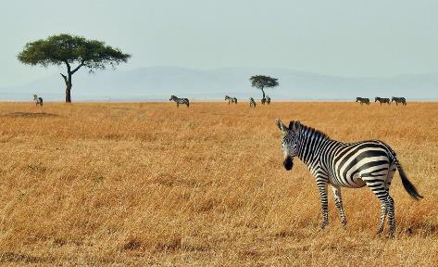
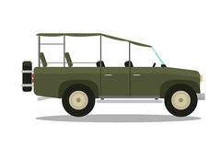
Lions
Video - Click on the safari jeep to learn more about life on the Savannah:
Zebra
Giraffe
Notes:
Images (clockwise from top left): Jeremy Avery, Unsplash; elCarito, Unsplash; Ron Dauphin, Unsplash

Slide 7
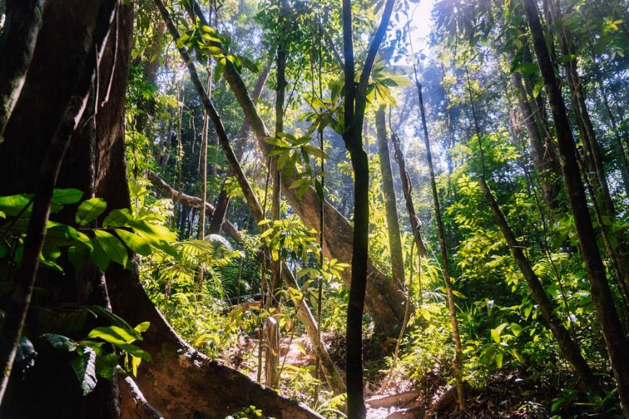
Tropical Rainforest
Notes:
Image: Nick van den Berg, Unsplash

Slide 8
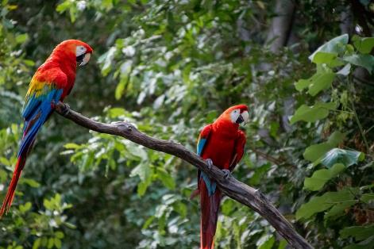
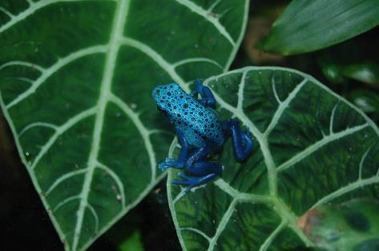
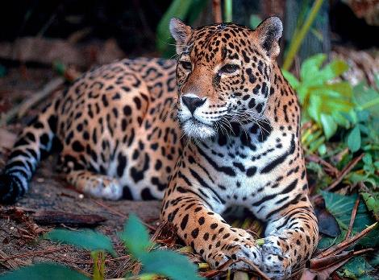
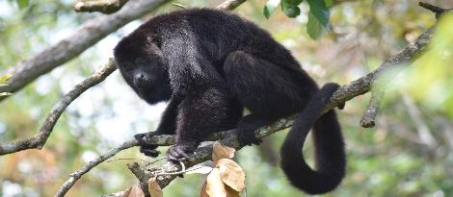
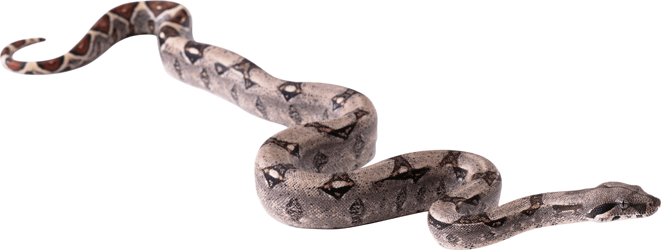
Scarlet Macaw
Poison Dart Frog
Monkey
Video - Click on the Snake to learn more about life in Tropical Rainforests:
Jaguar
Notes:
Images (clockwise from top left): Giovanni Poveda, Unsplash; skeeze, Pixabay; chiselart; Pixabay; skeeze, Pixabay

Slide 9
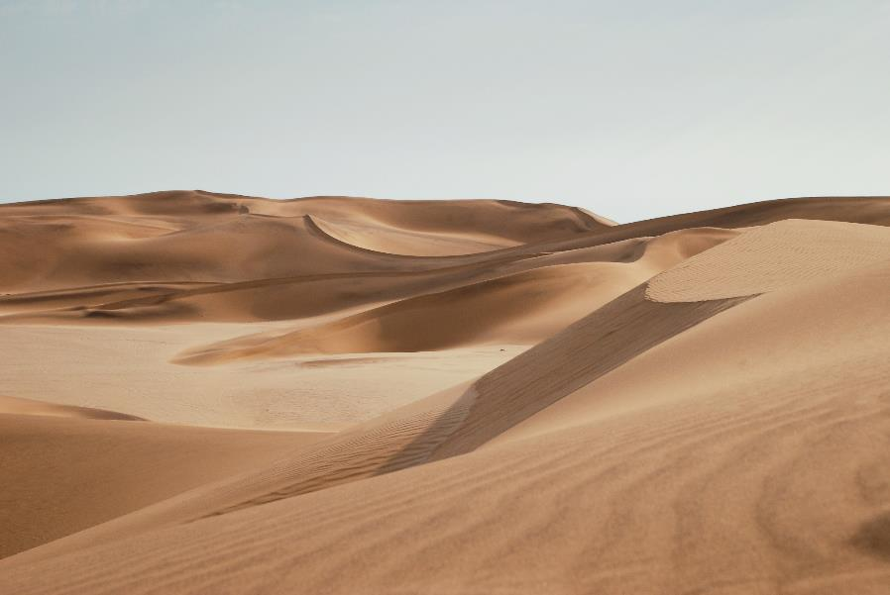
Desert
Notes:
Image: Keith Hardy, Unsplash

Slide 10
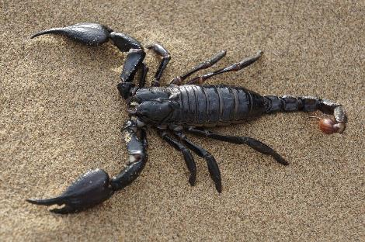
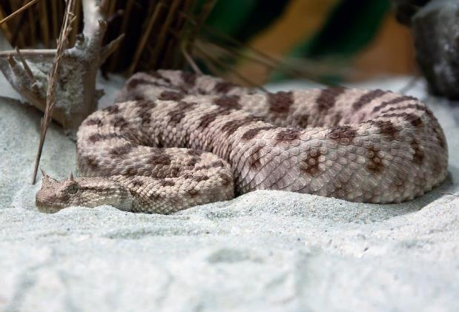
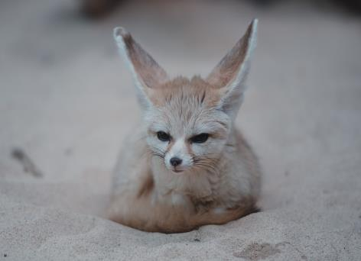

Scorpion
Sand Viper
Fennec Fox
Video - Click on the Cactus to learn more about life in the Desert:
Notes:
Images (clockwise from top left): andrey_barsukov, Pixabay; Foto-Rabe, Pixabay; Tj Holowaychuk, Unsplash

Slide 11
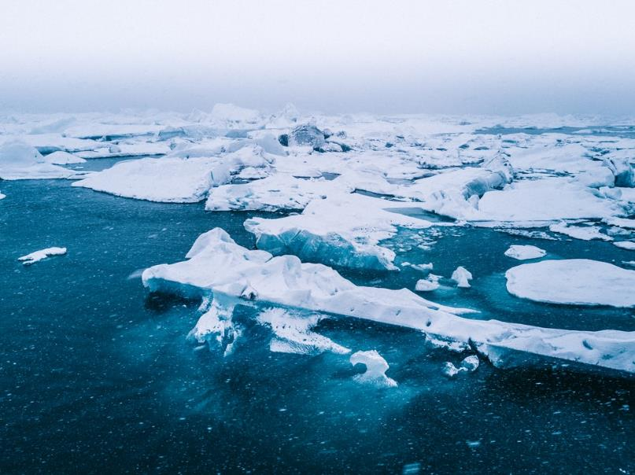
Arctic
Notes:
Image: Willian Justen de Vasconcellos, Unsplash

Slide 12
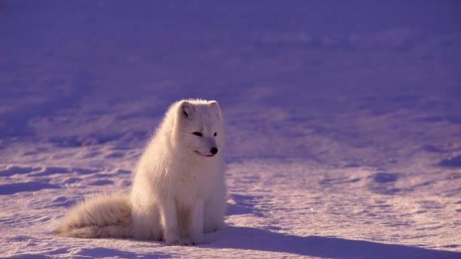
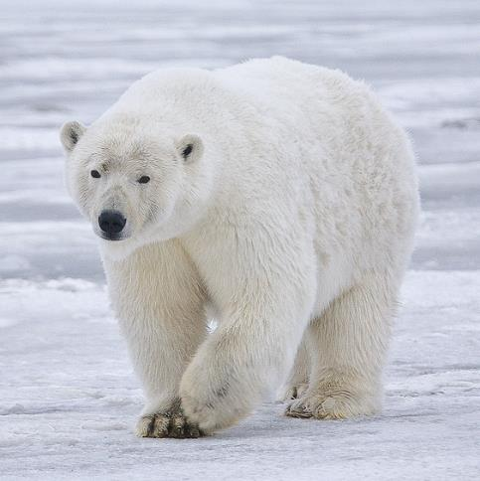
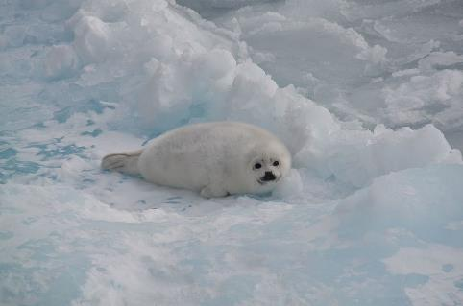

Arctic Fox
Polar Bear
Video - Click on the iceberg to learn more about how Polar Bears survive in the Artic:
Harp Seal
Notes:
Images (clockwise from top left): Alan Wilson, Wikimedia Commons; Jonatan Pie, Unsplash; Lysogeny, Pixabay

Slide 13
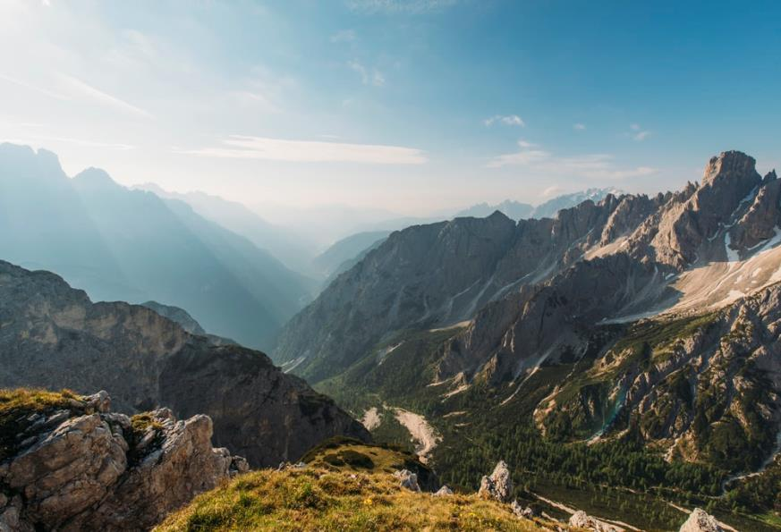
Mountains
Notes:
Image: Ales Krivec, Unsplash

Slide 14
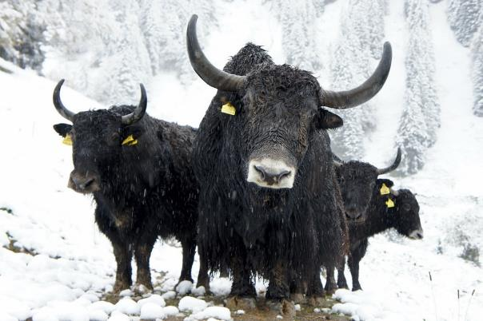
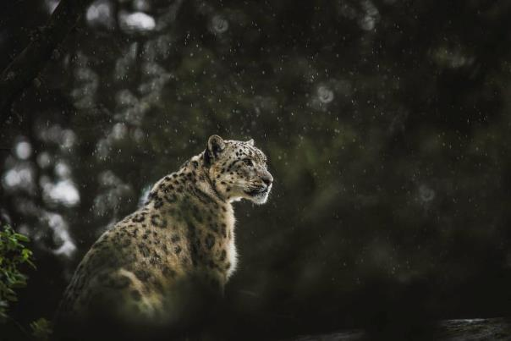
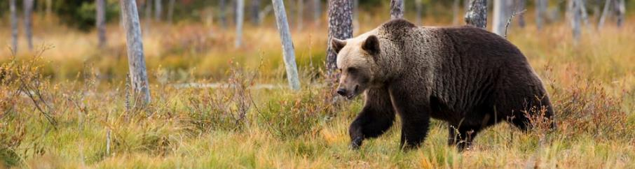

Mountain Yak
Snow Leopard
Video - Click on the walking boot to learn more about how Ibex’s incredible hooves are adapted for steep mountain slopes:
Brown Bear
Notes:
Images (clockwise from top left): Lieve Ransijn, Unsplash; Frida Bredesen, Unsplash; Zdeneck Machacek, Unsplash

Slide 15
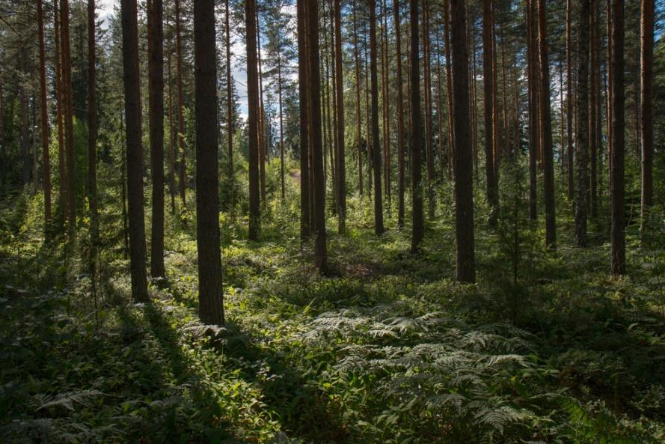
Temperate Forests
Notes:
Image: Rural Explorer, Unsplash

Slide 16
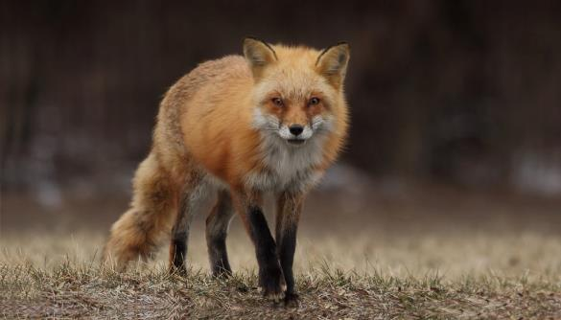
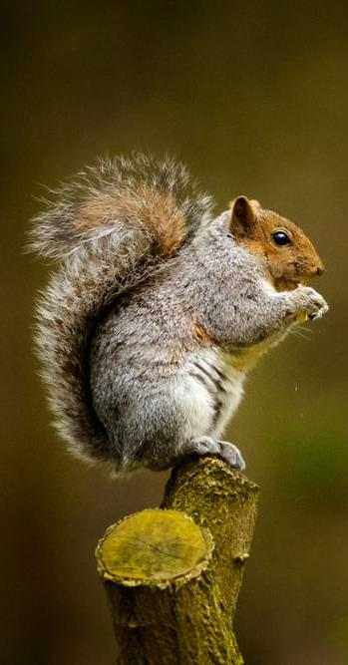
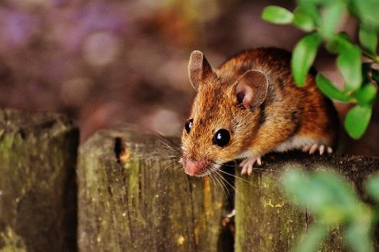
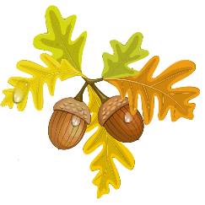
Red Fox
Video - Click on the Acorns to learn more about woodland animals:
Mouse
Grey Squirrel
Notes:
Images (clockwise from top left): Gary Bendig, Unsplash; Shane Young, Unsplash; Alexas_Fotos, Pixabay

Slide 17
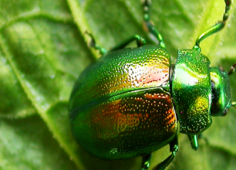
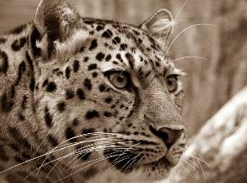
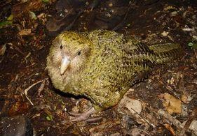
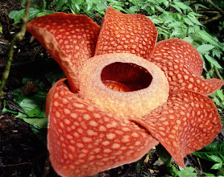

Endangered Species
Some animal and plant species are classified as endangered. This means they are very likely to become extinct in the near future, if nothing is done to help them.
Tansy Beetle
Amur Leopard
Kakapo Parrot
Rafflesia Flower
Did you know: The Rafflesia Flower is thought to be the largest flower in the world. It can grow up to a metre in diameter and emits a repulsive odor, similar to that of rotting meat!
Notes:
Images (left to right): Geoff Oxford, Wikimedia Commons; 3342, Pixabay; How Come Why Not, Wikimedia Commons; Henrik Ishihara, Wikimedia Commons

Slide 18
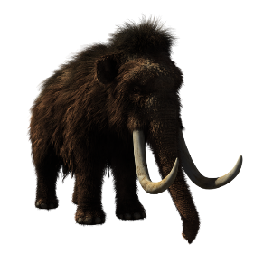
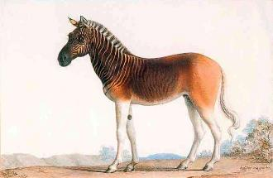
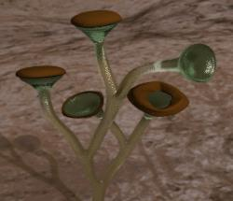

Extinct Species
Some animal and plant species are classified as extinct. This means there are no more individuals of that species alive anywhere in the world.
Woolly Mammoth
Quagga
Cooksonia Plant
Rocky Mountain Locust
Notes:
Images (left to right): tony241969, Wikimedia Commons; Nicholas Marechal, Wikimedia Commons; Smith609, Wikimedia Commons; Julius Bien , Wikimedia Commons.

Slide 19
Lesson 2 The Human Impact

Slide 20
Savannah
Notes:
Image: Bjorn Christian Torrissen, Wikimedia Commons

Slide 21

Tropical Rainforest
Notes:
Image: Nick van den Berg, Unsplash

Slide 22
Desert
Notes:
Image: Keith Hardy, Unsplash

Slide 23
Arctic
Notes:
Image: Willian Justen de Vasconcellos, Unsplash

Slide 24
Mountains
Notes:
Image: Ales Krivec, Unsplash

Slide 25
Temperate Forests
Notes:
Image: Rural Explorer, Unsplash

Slide 26
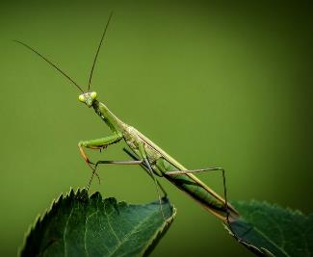
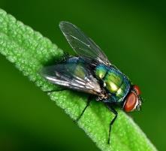
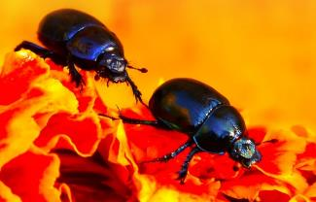
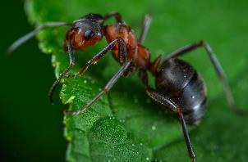
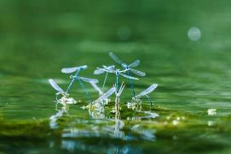

Insects
Insects are by far the most common animals on Earth; more than 1.5 million species have been named but there are many more that have not yet been discovered. They are incredibly diverse, differing in colour, size, shape and biology. They are found in almost every habitat in the world!
Without insects, the world would be very different. Insects pollinate many fruits, vegetables and flowers; without insects these plants would not grow. Can you think of any other reasons why insects are so important?
Did you know: Insects are believed to have been some of the first animals on land. The oldest fossil of an insect was discovered in 1926 by Robin Tillyard, an entomologist (a scientist who studies insects). The insect in the fossil is believed to have lived over 400 million years ago.
Notes:
Images (left to right): LubosHouska, Pixabay; Ekamelev, Pixabay; Krzysztof Niewolny, Unsplash; Juan Pablo Mascanfroni, Unsplash; Clement Falize, Unsplash.
Images bottom row: Ghedogohedo, Wikipedia.

Slide 27

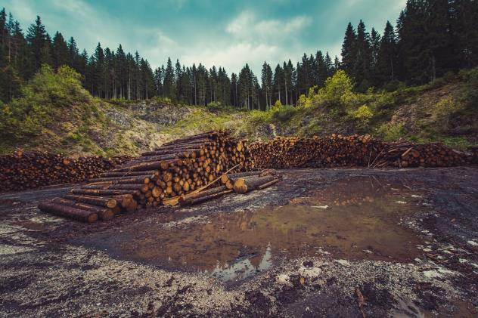
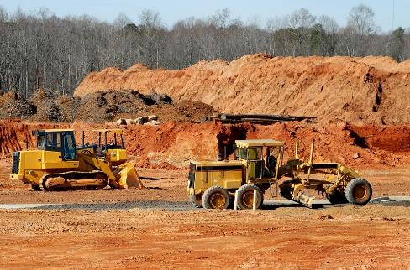
Habitat Destruction
Video - Click on the picture above for an introduction to deforestation.
Video - Click on the picture above for an introduction to habitat destruction.
Notes:
Images (left to right): Free-Photos, Pixabay; paulbr75, Pixabay

Slide 28
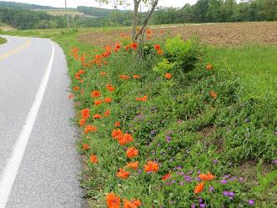
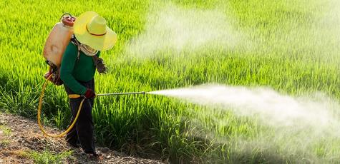
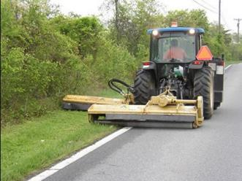
Habitat Destruction: Insects
Insects are found in almost every habitat in the world. Human activity has altered more than 75% of the Earths surface so this has had a big impact on insects; scientists have found that since 1990, insect numbers have declined by almost 25%.
Many flowers and other plants are regularly mowed down as it is believed to make the roadsides tidier. This however, destroys large areas of insect habitat and food.
Some farmers use pesticides to protect their crops from being eaten/destroyed by certain species of insects, which are viewed as pests. When sprayed over the crops, pesticides kill or harm all insects on them. As the human population continues to grow, we require more food so more land is being used for farming. This is having a huge impact on the insect population, as more of their habitat is being destroyed to grow crops and more pesticides are being used.
Notes:
Images top row (clockwise from top left): David Wilson, Wikimedia Commons; Christina Sarich, Safedenza; LGAM, Wikidot

Slide 29

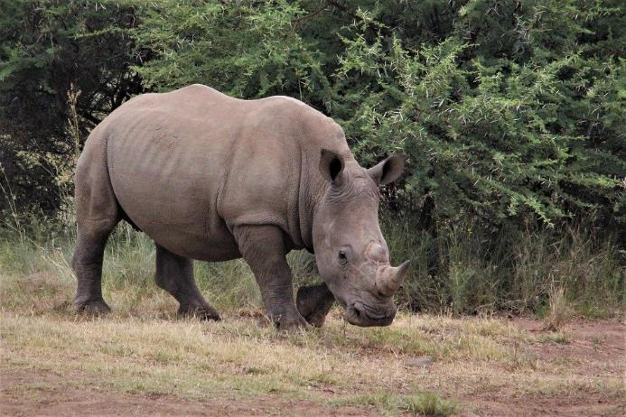
Habitat Protection
The last male Northern White Rhinoceros was under 24 hour protection until he died in 2018.
Video - Click on the picture above to learn more about endangered species protection.
Notes:
Image: Nel_Botha-NZ, Pixabay

Slide 30



Habitat Protection: Insects
Insects are vitally important to life on land. In order to help their numbers increase, we can work to protect their varied habitats.
Some people are writing to their local government representative to ask them to not mow down flowers and plants along their local roads.
Protect green spaces, such as parks, in cities and other built up areas; this ensures that insects can continue to thrive here. Are there any green spaces in your local area?
Many farmers are being encouraged to swap harmful chemical pesticides for alternative methods. Some farmers plant other plants alongside their crops which are more attractive to the insects; this protects their crops but still provides food for the insects.
Notes:
Images (left to right): Richard Cooke, Geograph; Manfred Sause, Wikipedia; Jorge Lascar, Wikimedia Commons.

Slide 31




Habitat Creation
Video - Click on the picture above to learn more about how new forests are being grown in Iceland for the first time in 1000 years.
Video - Click on the picture above to learn more about how new coral reefs are being created using 3D Technology.
Video - Click on the picture above to learn more about how to create a wildlife friendly garden.
Notes:
Images (left to right): Jonathon Ybema, Unsplash; Francesco Ungaro, Unsplash; Erda Estremera, Unsplash;

Slide 32



Habitat Creation: Insects
In order to help insect numbers increase, we can create more habitats.
Planting trees, flowers and other plants in your school grounds creates new habitats for insects. Try to plant a variety of different species, to attract lots of different types of insect. Is there anywhere you could do this in your school?
In some countries, farmers are now required to dedicate 5% of their land to creating habitats for insects and other wildlife. This could include planting hedges, leaving strips of land to grow wild, planting wildflowers, etc.
Create insect habitats in your home by growing plants on a windowsill or in pots, buckets, etc. Or plant wildflowers in your garden and let some parts of it grow wild.
Notes:
Images top row (clockwise from top left): SuSanA Secretariat, Flickr; Columbia.co.cr, GFAR; Sean Freese, Flickr.

Slide 33
Lesson 3 Food Chains

Slide 34







Rainforest Game
Trees
Blue Beetles
Red Birds
Orange Mammals
Humans
Notes:
This activity was created by Manchester Museum and inspired by Food Chain Checkers, a ‘Windows to the Universe’ activity by Lisa Gardiner: https://www.windows2universe.org/teacher_resources/checkers_20march.pdf Images: Manchester Museum

Slide 35

To start the game…
Each member of the group is assigned one of the five groups which they should play during the game. Refer to your task cards throughout the game to know the role of your group.
Start by placing the tiles on the game board in the following order:
Trees (producers) – Place 16 tiles
Blue Beetles (primary consumers/herbivores) – Place 8 tiles
Red Birds (second order consumers/carnivores) – Place 4 tiles
Orange Mammals (third order consumers/carnivores) – Place 2 tiles
Humans (top predators) – Place 1 tile
The aim of the game (aside from trees) is to stay alive!
Each player can move one piece every move. This is either to escape their predator or move towards/consume their prey.
Notes:
Images: Manchester Museum

Slide 36

Instructions
Rule 1: You can move up, down, left, right and diagonally.
Notes:
Images: Manchester Museum

Slide 37


Instructions
Rule 2: To reproduce you need to consume prey. To consume prey you must jump over it.
You can only jump over a piece if the square you are moving to is empty.
Once you have consumed a piece of prey, remove it and replace it with one of your own pieces.
Notes:
Images: Manchester Museum

Slide 38




Instructions
Rule 3: If you are at the edge of the board, you can move a tile to the opposite side of the board as long as the square you are moving to is empty.
Notes:
Images: Manchester Museum

Slide 39
Instructions
Rule 4: Play must be in the following order (except Round 1 where trees don’t have a turn).
Trees (producers)
Blue Beetles (primary consumers/herbivores)
Red Birds (second order consumers/carnivores)
Orange Mammals (third order consumers/carnivores)
Humans (top predators)
Round 1: Starts with blue beetles who either consume a tree or move a piece to avoid being consumed by a red bird. Red birds go next, then orange mammals and finally humans.
Round 2: If the blue beetles consumed a tree, the tree group can put a new tile on the board. Then blue beetles have a go, followed by red birds, orange mammals and then humans.
Round 3+: Repeat round 2 instructions
Notes:
Images: Manchester Museum

Slide 40


Discussion
Why did each group start with a different number of pieces?
How well has each group performed so far?
What factors are overlooked by this model that would change the outcome in real life?
Are human impacts always negative: What would happen if there were no indigenous people?
Do the indigenous people become part of the natural balance or do they disrupt it? Why and how do you think that this is the case?
Notes:
Images: Christopher Alvarenga, Unsplash; James Wainscoat, Unsplash

Slide 41







Interventions
Read your scenario card and action it in your game; how does it affect the animals and plants on your board?
Invasive Species = Ant
Invasive Species = Rodent
Road Built
Chemical Spill
Flooding by Mining Company
Desertification
Logging
Notes:
Images: Manchester Museum

Slide 42


Discussion
What intervention happened in your game?
Can you describe how this intervention impacted on your own group and the game overall?
Do you think your intervention could be reversed? If so, how?
Notes:
Images: Etienne Girardet, Unsplash; Shane McLendon, Unsplash.

Slide 43

Rabbit
Notes:
Image: Gary Bendig, Unsplash

Slide 44

Eagle
Notes:
Image: Bryan Hanson, Unsplash

Slide 45

Spider
Notes:
Image: Ed van duijn, Unsplash

Slide 46

Bear
Notes:
Image: Camerauthor Photosandstories, Unsplash

Slide 47

Wolf
Notes:
Image: Vincent van Zalinge, Unsplash

Slide 48

Hedgehog
Notes:
Image: Bill Fairs, Unsplash

Slide 49

Deer
Notes:
Image: Pedro Lastra, Unsplash

Slide 50

Human
Notes:
Image: Harishan Kobalasingham, Unsplash

Slide 51





Elephant
Elephants are huge so they require an enormous amount of food! They may spend 12 – 18 hours feeding a day, eating between 200 – 600 pounds of food in this time.
To find all the food and water they need, an Elephants habitat can span over 60 miles.
Notes:
Image (from top left): Kidaha, Pixabay; Humberto Arellano, Unsplash; Sam Power, Unsplash; arrowmaze, Pixabay; Tobias Adam, Unsplash.

Slide 52




Ant
Ants eat almost anything but they particularly like sugary foods, such as flower nectar, and plants, leaves, seeds and other insects.
Ants are very strong and fast. They work in large numbers, to find and bring back food to their colony. They travel up to 90 metres from their nest to find food.
Notes:
Image (clockwise from top left): Ehimetalor Akhere Unuabona, Unsplash; qinghill, Unsplash; RoyBuri, Pixabay
Image (right): Dhanush Satyan, Unsplash

Slide 53




Kangaroo Rat
Kangaroo Rats eat seeds from desert grasses as well as beans and very occasionally insects.
Kangaroo Rats live in underground burrows. They come out at night, when it is cooler to look for food. They are only 8 – 14cm long so although they have to travel quite far some nights to find enough seeds to eat, their habitat is relatively small.
Kangaroo rats are perfectly adapted for life in the desert; they can survive without ever drinking any water! Instead they get any needed moisture from their seed-rich diet.
Notes:
Images (left to right): Wesley Tingey, Unsplash; $1LENCE D00600D, Wikimedia Commons; Pacific Southwest Region, Wikimedia Commons; Kidaha, Pixabay

Slide 54





Fox
Foxes eat a large variety of foods, including worms, rabbits, mice, fruit, berries and small birds.
Red foxes who live in urban areas often have a smaller habitat (approx. 1-2 square miles) than those that live in rural areas (approx. 5-10 square miles).
Notes:
Images (top left to right): Aruna, Wikimedia Commons; Anastasiya Romanova, Unsplash; Colter Olmstead, Unsplash; Mathew Schwartz, Unsplash; Gary Bendig, Unsplash, Kidaha, Pixabay.

Slide 55





Fruit Bat
Fruit bats, as their name suggests, eat a lot of fruit. This ranges from mangoes to avocados.
Fruit bats are the only mammals in the world that can fly. During certain times of year they may have to travel long distances (up to 5o miles) to find food, returning to their roost before the sun comes up.
Notes:
Images (left to right): Felipe Vieira, Unsplash; Wimber Cancho, Unsplash; dimitrisvetsikas, Pixabay; Gary Bendig, Unsplash; Kidaha, Pixabay.

