Slide 1

Life on Land
Schools Connect
Understanding ecological interconnectivity

Slide 2
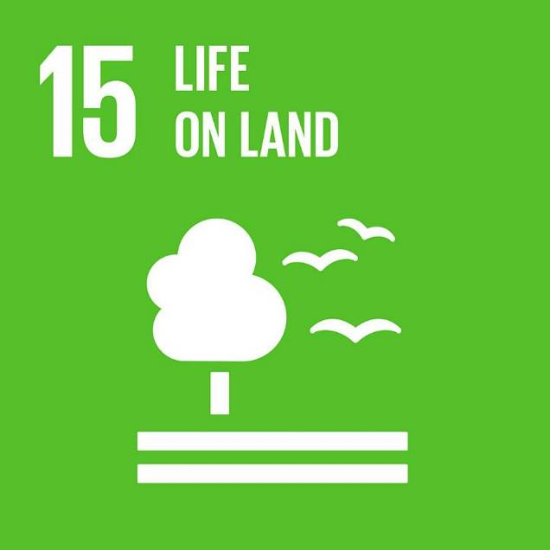
Lesson 4 Learning About the Past From the Present

Slide 3

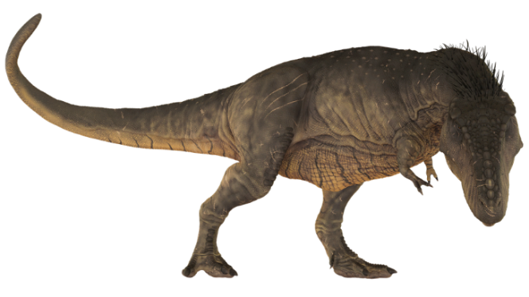
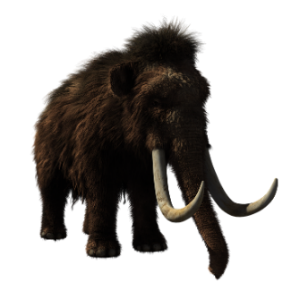
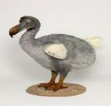
Welcome to the Natural History Museum
Notes:
Images (left to right): ReaperDZ, Pixabay; tony241969, Pixabay; Yoann Siloine, Unsplash; OpenClipart-Vectors, Pixabay

Slide 4
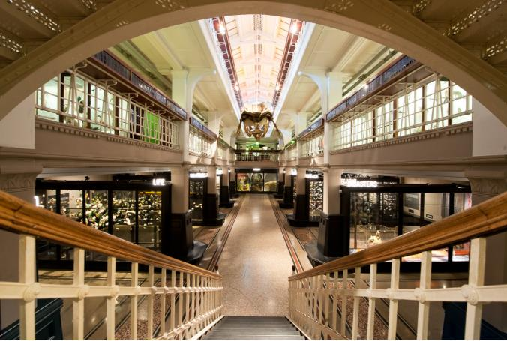
Notes:
Image: Ant Clausen, Manchester Museum

Slide 5
Lesson 5 Learning About the Past From the Present

Slide 6
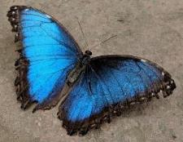
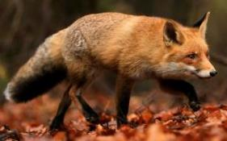
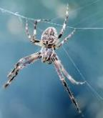
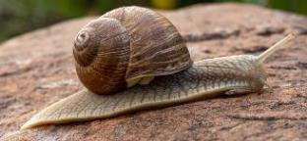
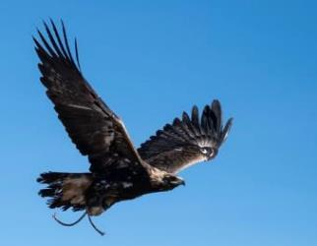
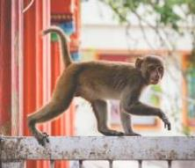
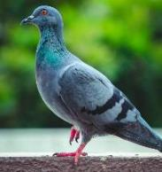
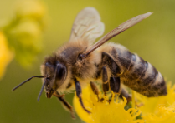
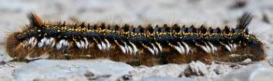
What animals live in your
local area?
Don’t forget to think both big and small!
Notes:
Images top row (clockwise from top left): Anne Lambeck, Unsplash; Zdenek Machacek, Unsplash; Dev Leigh, Unsplash; Zdenek Machacek, Unsplash; Lightscape, Unsplash; Trollinho, Unsplash; Wolfgang Hasselman, Unsplash; Kalpesh Patel, Unsplash; Dil, Unsplash;

Slide 7

Dangers
Invasive Species
Habitat Loss
Litter
Climate Change
Hunting
Pollution
Notes:
Image: Clker-Free-Vector-Images, Pixabay

Slide 8
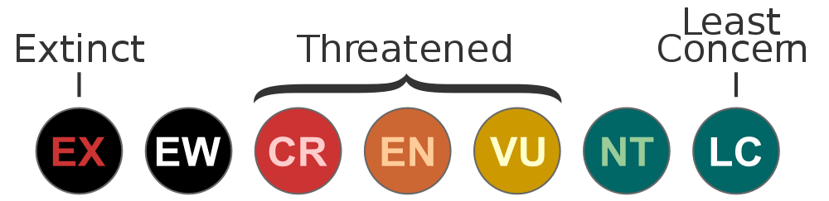
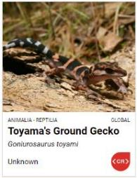

IUCN Red List
The IUCN (International Union for Conservation of Nature) Red List shows the conservation status of plant and animal species around the world.
Critically Endangered
Near Threatened
Least Concern
Extinct
Extinct in the wild
Endangered
Vulnerable
You can use the search bar on their website to find the conservation status of animals and plants in your local area and around the world:
https://www.iucnredlist.org/
Notes:
Images (left to right): Richard Cooke, Geograph; Manfred Sause, Wikipedia; Jorge Lascar, Wikimedia Commons.

Slide 9
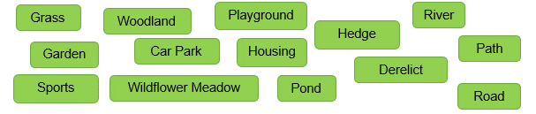
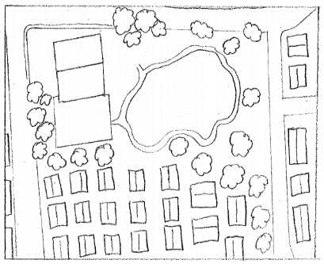
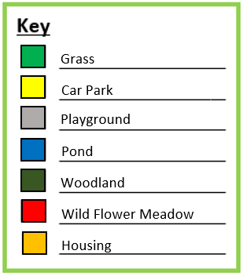
Mapping Habitats
1. Walk around your school grounds/local area; how is land being used?:
2. Draw a map, then colour it in to show the different habitats that you found. Make sure you make a key so your map can be understood!
3. Do you think any of the habitats are more likely to be home to a higher number of animals/plants? Why?
Notes:
Images (left to right): Richard Cooke, Geograph; Manfred Sause, Wikipedia; Jorge Lascar, Wikimedia Commons.

Slide 10
Lesson 6 Invertebrate Investigation

Slide 11
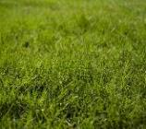
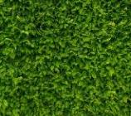
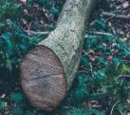
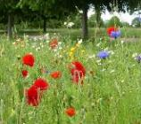
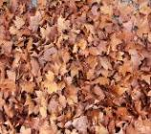
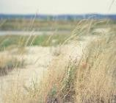
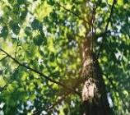

Habitats to Explore
Short Grass
Hedge
Logpiles/Under Logs
Wildflowers
Leaf Litter
Long Grass
Trees and Woodland
Playground
Notes:
Images: Unsplash

Slide 12
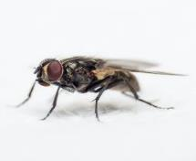
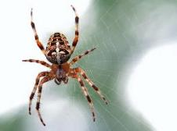
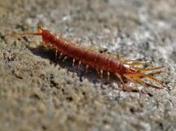
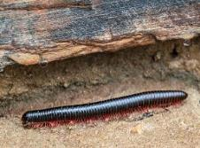
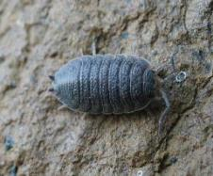

Minibeasts
Minibeasts can also be known by the more scientific name invertebrates. They are animals without backbones and include:
Insects
Arachnids
Centipedes
Millipedes
Crustaceans

Slide 13
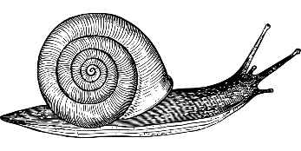


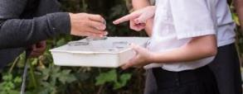

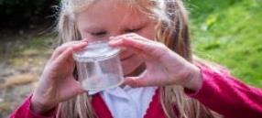

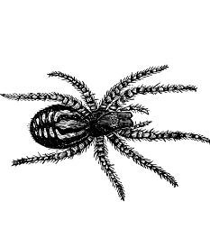
Minibeast Investigation
There are lots of different ways and places to find minibeasts! Here are some ideas:
Use a sweep net to sweep through long grasses.
Look under stones and logs.
Hold a white tray/ white sheet/white piece of paper under trees/plants and gently shake the branches or plant. Some minibeasts will fall out and show up against the white background (very few minibeasts are white).
Use a magnifying glass to take a closer look.
Use a bug pot to carefully catch a minibeast.
Notes:
Images: Clker-Free-Vector-Images, Pixabay; NHBS; OASES
Spider: GDJ, Pixabay
Worm, Snail: OpenClipart-Vectors, Pixabay

Slide 14
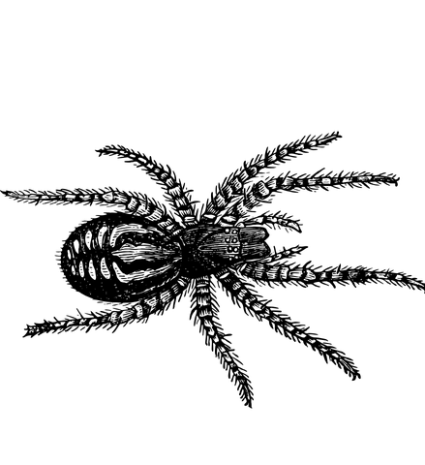
Minibeast Investigation
Remember all minibeasts are living creatures so it is important to take care of them when carrying out a minibeast investigation:
If you are using a bug pot, only have one minibeast in at a time; some minibeasts like to eat others!
Please look after me
Be gentle! Minibeasts are much smaller than you are.
Keep yourself safe; if you find a minibeast which can sting, don’t try and touch or collect it. Report any stings to an adult.
Once you have finished looking at a minibeast, make sure you put it back where you found it.
Don’t put your hands in your mouth. Wash your hands after the minibeast investigation.
Notes:
Images: Unsplash

Slide 15
Lesson 7 Who is to Blame?

Slide 16
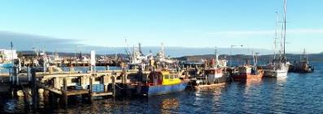
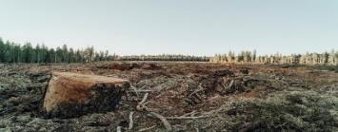
Threats
Deforestation
Building
Litter
Climate Change
Disease
Food
Pollution
Poaching
Pesticides
Invasive Species
Notes:
Images (left to right): Bj Pearce, Unsplash; Roya ann miller, Unsplash

Slide 17
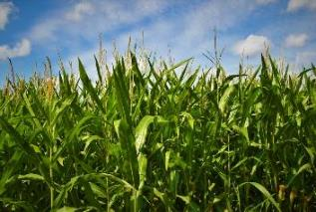
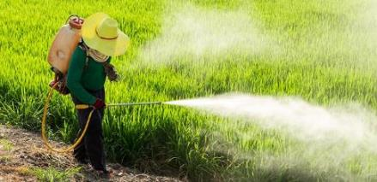
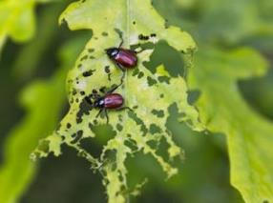
Pesticides
Pesticides = a substance used to destroy insects (insecticides), weeds (herbicides) or fungi (fungicides) that are considered to be unwanted.
Often pesticides are used on plants that are grown for human usage e.g. for food, medicine, etc. to protect them from being destroyed.
However, pesticides can also have a negative impact:
They are not always targeted, so they can harm or kill other insects in addition to the pests. It can also affect other animals in the food chain, such as birds, who can ingest the harmful pesticides when they feed on the insects.
Pesticides sprayed near water (e.g. rivers, streams) can run off the fields into the water, which then becomes more acidic. This can harm animals living in the water and even lead to acid rain.
Some pesticides can be harmful to human health.
Notes:
Images: Unsplash

Slide 18
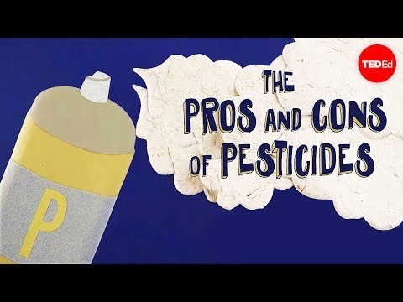
Watch the video to learn more about pesticides
List out the pros and cons of pesticides. Do you think they should continue to be used or should we be using alternatives?
Are pesticides used in your local area? What impact might they have on local animals and plants?
Research alternatives to pesticides. How could you raise awareness in your local community?
Notes:
Images: Unsplash

Slide 19
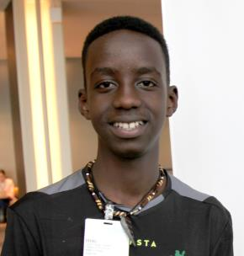
Lesein Mutuneki
After learning about how deforestation and climate change is affecting habitats across Kenya, Lesein decided to take action. Combining his love of football and his passion for change he founded Trees for Goals (T4Gs). For every goal he scores he plants a tree. Since founding Trees for Goals, Lesein has planted over 1000 trees and supported them to grow. In the future he dreams of planting a forest of trees for goals in every county in Kenya.
Notes:
Image: timeforkids.com

Slide 20

Greta Thunberg
Greta started by writing an essay on how climate change was impacting life on land across the world, which went on to win a local newspaper competition and raise awareness. Greta was then inspired to take further action so she started protesting in front of the Swedish parliament building to demand action from the Swedish government leaders. She has since spoken to world leaders at the United Nations (UN) Climate Conference.
Notes:
Image: Anders Hellberg, Wikimedia Commons

Slide 21
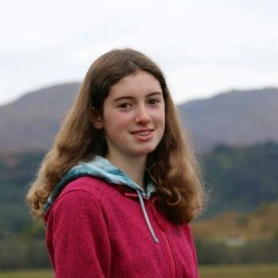
Holly Gillibrand
Holly believes there should be more opportunities in school to get outside and interact with nature. She campaigns for more lessons to be moved outside of the classroom, into the school grounds and local area. In this way more children will get a chance to learn about and care for the animals and plants in our world.
Notes:
Image: Holly Gillibrand (@HollyWildChild, Twitter)

Slide 22
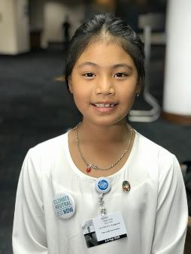
Licypriya Kangujam
Licypriya campaigns for new laws to address poor air quality in India. Rising pollution levels are affecting both animals, including humans, and plants; sometimes schools have to close because the pollution levels are so high that the children cannot get to school safely. Licypriya also wants climate change to become a compulsory school subject and so far her campaigns have managed to get several states in India to agree.
Notes:
Image: Dilanlekamge, Wikipedia

Slide 23
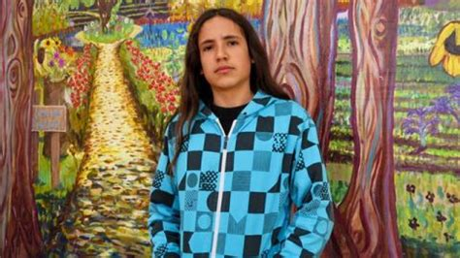
Xiuhtezcatl Martinez
Xiuhtezcatl (pronounced shoe-tex-caht) is an indigenous climate activist. He shares how his connection to the natural world has influenced him as a young leader. As a young leader, he has addressed many leaders and politicians, including the UN (United Nations), demanding action on climate change to protect the biodiversity of our planet. He also creates hip-hop music to communicate the stories of climate change movements and events.
Notes:
Image: Bill Moyers (Creative commons licence)

Slide 24

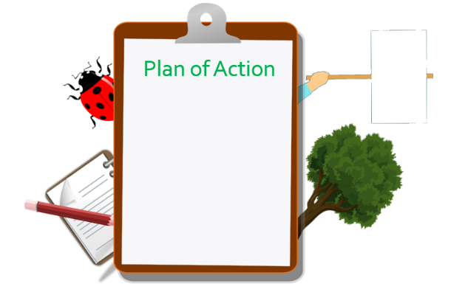
Now it is your turn to take action for life on land! Make a plan of action, which you will carry out in your school grounds or local area to support/encourage biodiversity.
Think Local: how could you improve biodiversity in your school grounds or local area? Are there any threats to biodiversity in your local area?
Be Creative: use your unique skills and interests to help you.
Collaborate: are there any places or local organisations who you could take action with?
Notes:
Image (top left corner): PicServer
Images (clockwise from top left): Frantisek_Krejci, Pixabay; mohamed_hassan, Pixabay; OpenClipart-Vectors, Pixabay; OpenClipart-Vectors, Pixabay
Image (top left corner): PicServer
Images (clockwise from top left): Frantisek_Krejci, Pixabay; mohamed_hassan, Pixabay; OpenClipart-Vectors, Pixabay; OpenClipart-Vectors, Pixabay

Slide 25
Take Action!
Litter Pick: Keep habitats clean.
Raise Awareness: Make posters, leaflets and information sheets.
Have you noticed lots of litter in a local place e.g. a park? Plan a litter pick to collect the litter to improve the habitat of local animals and plants.
Resources you may need:
Gloves
Binbags
Litter pickers
Something to think about: What are you going to do with the litter once you have collected it?
Is there a particular issue you want to tackle (e.g. pesticides)? Or do you want encourage people to take action (e.g. plant trees) or simply raise awareness about the importance of biodiversity on land?
Resources you may need:
Pens
Paper
Something to think about: Think about your target audience; what is the best way to communicate with them?

Slide 26
Take Action!
Demand Action: Write to your local government representative or stage a protest.
Build Habitats: Make bug hotels, bird boxes and small mammal homes. Plant trees or wildflowers.
Is there an threat to biodiversity in your local area which you think the local government needs to take action on? Write to your local government representative to outline the issues and why it matters to you; perhaps you could suggest some solutions?
Resources you may need:
Computer
Pens
Paper
Something to think about: Make sure to include your school’s name and address so they can contact you.
Are there any areas where you could encourage more biodiversity? Perhaps there is an empty area of your school grounds where you could plant wildflowers to attract pollinator insects such as bees? Or perhaps you could build a bird box and work with your local council to identify somewhere to put it in your local area?
Resources you may need:
Pieces of wood, including sticks
Seeds
Something to think about: How will you monitor your new habitat?

Slide 27
Take Action!
Support Scientists
Fundraise: Raise money for charities who help wildlife.
Help scientists build a better picture of what species live where and whether their numbers are being impacted by human influence. Record and monitor the species in your area, through an investigation, and then put your results into an online database such as iRecord.
Resources you may need:
Computer
Pens
Paper
Something to think about: Are there any local scientists you could work with? Perhaps they need help investigating a particular species?
Are there any local wildlife charities you could collaborate with or support? Raise money through activities such as sponsored walks, bake sales, fundraising campaigns, etc. Be creative!
Resources you may need:
Computer
Space to carry out activity e.g. school hall
Pens
Paper
Something to think about: Make sure you research what local wildlife charities do before choosing one (or more) to fundraise for, so you can explain to donators where their money will be going and how it will have an impact.

Slide 28
Lesson 8 Habitat Protection and Creation

Slide 29


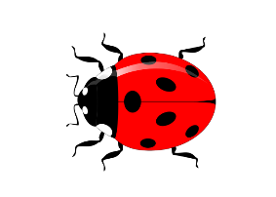


Plan of Action
Today you will carry out your plan of action! Check you have all the resources you need before getting started.
Notes:
Images (clockwise from top left): Frantisek_Krejci, Pixabay; mohamed_hassan, Pixabay; OpenClipart-Vectors, Pixabay; OpenClipart-Vectors, Pixabay

Slide 30
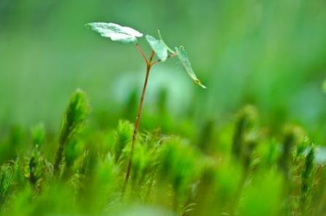

Could you monitor the impact of your action?:
Carry out a minibeast investigation just after building a new habitat and a few months later; is there a difference in the number of minibeasts you find?
Do you receive a reply from your local government? What action are they going to take?
Are your family/friends/local people more educated on biodiversity and the threats impacting it in your local area?
Carry out a litter survey; is there less than before?
Notes:
Image (left to right): Austin D, Unsplash; Trinity Treft, Unsplash

Slide 31
Lesson 9 Caring and Sharing

Slide 32
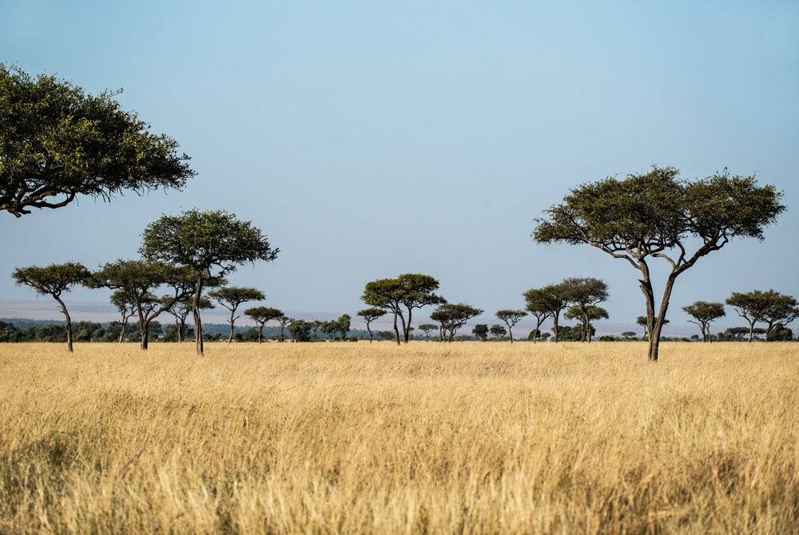

Black Mamba Anti-Poaching Unit
The Black Mamba Anti-Poaching Unit are dedicated to protecting wildlife in the Greater Kruger National Park in South Africa. They are inspired by a need to protect South Africa’s natural heritage for future generations.
They protect the local wildlife by patrolling the park looking for poacher camps and wildlife snares.
Since their founding, in 2014, they have reduced poaching activities by 93%.
Notes:
Image: blackmambas.org

Slide 33

Sir David Attenborough
Since 1951, David has been writing, presenting, narrating and producing wildlife documentaries. He has inspired millions of people to care for and protect our natural world by introducing them to plant and animal species from around the world.
In 1985 he received a knighthood honoring his work.
Notes:
Image: Department of Foreign Trade and Affairs website – www.dfat.gov.au, Wikimedia Commons

Slide 34


Wangari Maathai
Wangari founded the “Green Belt Movement” in 1977, to plant trees across Kenya.
Since its founding the Green Belt Movement has planted over 51 million trees, empowering people of all ages to take environmental action.
The Green Belt Movement inspired the United Nations to launch a worldwide campaign which resulted in 11 billion trees being planted.
In 2004, Wangari won the Noble Peace Prize for her lifetime work.
Notes:
Image: Meaduva, Flickr

Slide 35


Kishor Rithe
Kishor founded the Satpuda Foundation in 2001, which works to save Tigers, their forest homes and other wildlife through education, grassroots conservation and supporting local communities.
By working with local communities, researchers, biologists, media and politician, Tigers have received increased protection and the number of Tigers has nearly doubled since 2010.
Notes:
Image: Sanctuary Asia

Slide 36


Bayarjargal Agvaantseren
Bayarjargal worked as a language translator until she translated a research paper for the Snow Leopard Trust. The information in the research paper inspired her to dedicate the rest of her career to saving snow leopards, who were losing vast areas of habitat due to mining.
After campaigning and working with local people to raise awareness, she persuaded the Mongolian government to create a 1.8 million acre nature reserve, Tost Tosonbumba, and cancel all mining activity within this reserve. This reserve now protects snow leopards and their habitat.
Notes:
Image: mainnews.net

Slide 37




Share
Share your experience and learning with your peers, families, friends, local community and wider community to raise awareness of the need to protect and encourage biodiversity.
Tweet @Schools_British – we would love to hear about your action and experiences!
Notes:
Images (left to right): Let’s Move!; Kelly Sikkemam, Unsplash; Keesler Air Force Base

Slide 38

Further Reading
UN Report 2019 - Nature’s Dangerous Decline ‘Unprecedented’; Species Extinction Rates ‘Accelerating’ https://www.un.org/sustainabledevelopment/blog/2019/05/nature-decline-unprecedented-report/
WHO Report 2020- What does biodiversity mean for human health? https://www.who.int/globalchange/ecosystems/biodiversity/en/
Sir David Attenborough calls for a new deal for nature https://www.wwf.org.uk/updates/sir-david-attenborough-calls-new-deal-nature
“The future of all life now depends on us” – Sir David Attenborough https://www.outdoorphilosophy.co.uk/life-cycle/biodiversity/
LIVING PLANET REPORT 2018: Aiming higher https://wwf.panda.org/knowledge_hub/all_publications/living_planet_report_2018/
Living Planet Report 2018 Youth Edition https://www.worldwildlife.org/publications/living-planet-report-2018-youth-edition
Monitoring and maintaining the environment GCSE Biology https://www.bbc.co.uk/bitesize/guides/zswg7p3/revision/2
What is biodiversity? May 2019 https://www.worldwildlife.org/pages/what-is-biodiversity?utm_campaign=wild-classroom&utm_medium=web&utm_source=partner-site&utm_content=biodiversity-resources

