Slide 1



Pupil Attitudes to Languages
UK-Wide Findings on
2,083 pupils from 36 schools in England, Northern Ireland, Scotland and Wales completed our 2023 survey on pupil attitudes to language learning. All pupils had either just completed, or were about to complete, their first year of secondary education.
73%
of pupils told us that primary school pupils should have the opportunity to learn languages if they want.
76%
of pupils learnt a language at primary level. The most taught language at primary was French (60%), followed by Spanish (30%).
61%
of pupils are interested in the history and culture of the languages that they learn.
We asked pupils what languages they had learned as part of the normal school day in the 2022/23 school year:
46%
of pupils love or like learning a language. Only 16% don’t like or hate language learning.
Prior to data collection, ethical approval was secured from the Research Ethics Committee at the School of Social Sciences, Education and Social Work at Queen’s University Belfast. All participants gave their voluntary and informed consent to participate.

Slide 2
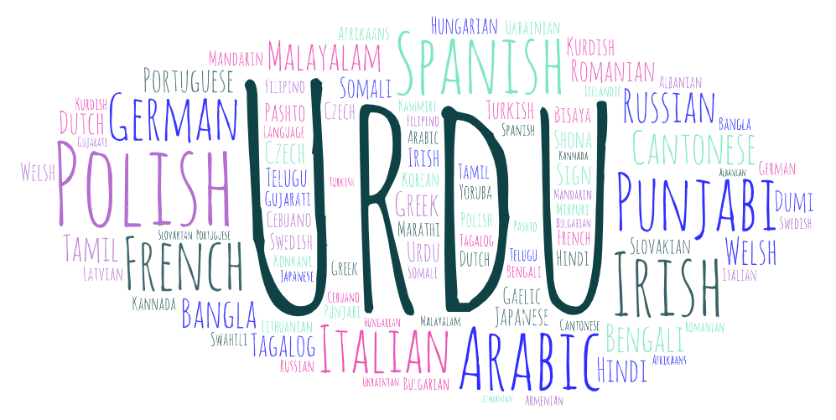
Do you plan to study a language for GCSE/National 5?
20%
54%
26%
1 in 4
pupils do not plan to study a language for GCSE/National 5. Pupils told us that languages are boring or too difficult, they don’t need to learn a language or don’t enjoy learning a language.
Yes
Maybe
No
Despite the rich tapestry of languages spoken by pupils, many do not see the value of learning a language. We asked pupils about the likelihood that they would use languages in their future job when they leave school. Using a Net Promoter Score with a scale of 0 to 10, pupils’ answers were divided into promoters (9, 10), passives (7,8) and detractors (0-6). Most pupils were detractors, meaning that 86% of pupils do not think it is likely that they will use languages in their future careers. Only 4% were promoters.
We received a more varied response when we asked pupils how useful they think it is to be able to speak different languages, with 41% detractors and 31% promoters; this leaves 29% of pupils who are currently passive, but who could be swayed to become promoters. After their first year of language education at secondary level, only 9% of pupils feel that they can speak a language well.
The UK is a rich melting pot of linguistic diversity with over 50 languages spoken at home by the pupils we surveyed:

