Slide 1

Sudan Skills System (TVET)
Nazar Majzoub
Assistant Director, CTC Engineering
Notes:
There is no doubt that TVET is a crucial vehicle for achieving social equality and inclusion’
Everyone is able to have equal opportunity to accessible high quality training through acquiring necessary skills and enhance opportunities

Slide 2
Why Focus on Vocational Education
Sudan Demographics
  40% of population <15 years old
  20% of the population <15-25%
  36% unemployment rate of youth
  Women are vastly underrepresented
TVET is critical factor for achieving social equality and inclusion and economical development
  People are able to have equal opportunity and accessible entry to high quality training
  It provides necessary skills and Enhance employability
  Empowers young girls and boys and promote the development of life skills that they need to succeed.
  Provide job opportunities
  Create skilled labor force for industrial development
Notes:
There is no doubt that TVET is a crucial vehicle for achieving social equality and inclusion’ WHY?
Everyone is able to have equal opportunity to accessible high quality training through acquiring necessary skills and enhance opportunities fro employment
And
Employment is an important ingredient for combating poverty and achieving inclusion

Slide 3
Factor affecting TVET in Sudan
Outdated/Irrelevant of provision
  Outdated Curriculum
  Growing skills Gap
Uncoordinated institutional governance/stakeholder
  Lack of proper apprenticeship program
  No formal occupational standards for TVET
  Admission Policies
Severe deficiency of finance
  Lack of facilities and materials
  Limited number of vocational institutes
Social Stigma
  TVET has traditionally been stigmatized in favor of white-collar jobs
  Women are vastly under-represented (preference or culture?)
  Less pay for vocational jobs
  Upscale tech to engineer!!!!

Slide 4
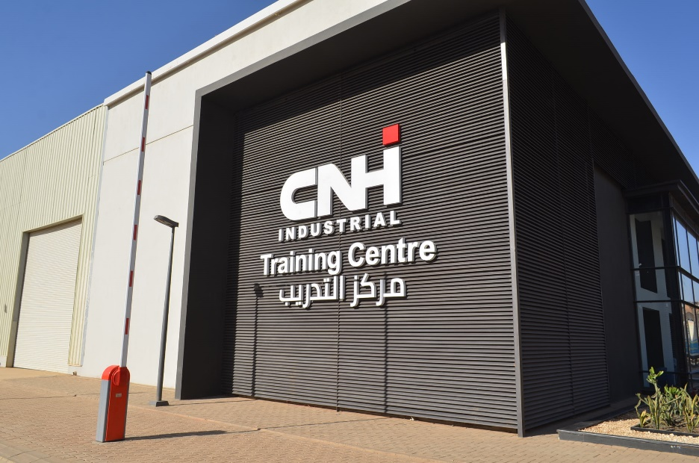

Slide 5
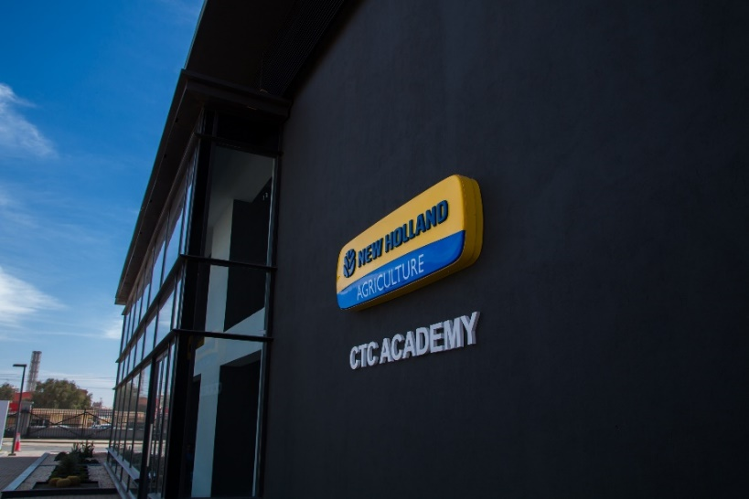
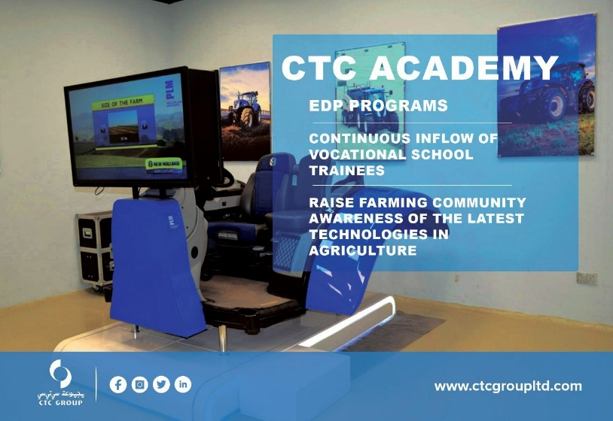
What We do at CTC
On job training
  Targets Vocation schools students
  Fill open position from the pool created
Technician Development Program
  Full time hire
  6-12 month classroom and hands on training
  90% hire rate
Operators Development Program
  CTC and customers Operators
  Classroom, simulators and field training
  Operator’s school o be launched in Q3 2023
Air Conditioning Technician skill program
  Skill based short training
  Open all year for enrollment

Slide 6

CTC TDP Certifications
Level 1 Certificate
Level 2 –Certificate (Selective)
Introductory Module
  Group overview, Company policies, product line, ..etc.
Basic Service training
  Basic Powertrain
  basic hydraulics
  Basic Electrical
  Basic Troubleshooting
Soft skills
  Interpersonal skills
  Technical English
  Computer skills, …etc
Advanced Service
  Machine diagnostics
  Failure analysis
  Advanced machines systems
  Selective Machine technical Training
Service Management
  Service KPs: Utilization, Tech efficiency Billing efficiency
  Job card: Service report,

Slide 7

CTC ODP Certifications
Basic Operator Certificate (LHP Tractors)
  Prepare machine for operation
  Basic machine Operation
  Basic care and maintenance
Skilled Operator Certificate Level 1
  Use of cabinet controls (MHP & HHP)
  Use of advanced automated features
  Basic machine troubleshooting
Skilled Operator Level II Certificate
  Understand advanced precision farming tools
  Understand the advantages of using precision farming
  Able to operate machines with precision farming package

Slide 8

DEM Academy RAC Certifications
DEM Academy is partnership with LG Electronics
Course Calcification
  Basic RAC
  Installation & Service
  Design
Certification
  RAC Installation
  RAC Service
  Single CAC Installation % troubleshooting
  Multi V Installation & Troubleshooting
  Multi V Troubleshooting
  HVAC Design

Slide 9
Conclusion
A well designed and coordinated TVET system is a must for sustainable economical development,
  Inclusive with added focus on women
  Easily accessible
  With an updated and relevant provision
A modern and responsive TVET system that take into account
  Current and expected socio-economic conditions
  Well funded, coordinated and governed TVET System
  An Employer centric system
  Professional capacity of TVET teachers and instructors

Slide 10
Thank you

