Slide 1

Sustainable Cities and Communities: Clean Air
Schools Connect

Slide 2

de Bono’s Thinking Hats – Feelings
Red
Thinking
Hat
Feelings
What are my feelings
right now?
Feelings can change.
No reasons need to be given.
Intuition, hunches, gut instinct.

Slide 3

de Bono’s Thinking Hats – Information
White
Thinking
Hat
Feelings
What are my feelings
right now?
Feelings can change.
No reasons need to be given.
Intuition, hunches, gut instinct.
Information
Information and data.
Neutral and objective.
What do I know?
What do I need to find out?
How will I get the information?

Slide 4

de Bono’s Thinking Hats – Cautions
Black
Thinking
Hat
Feelings
What are my feelings
right now?
Feelings can change.
No reasons need to be given.
Intuition, hunches, gut instinct.
Cautions
Spotting the risks.
Difficulties, weaknesses, dangers.
Logical reasons are given.
Spotting the risks/challenges.

Slide 5

de Bono’s Thinking Hats – Benefits
Yellow
Thinking
Hat
Feelings
What are my feelings
right now?
Feelings can change.
No reasons need to be given.
Intuition, hunches, gut instinct.
Benefits
Positives, plus points.
Logical reasons are given.
Why an idea is useful.
Highlight the positives.

Slide 6

de Bono’s Thinking Hats – Creativity
Green
Thinking
Hat
Creativity
What new ideas are possible?
Alternatives.
Can I create something new?
Solutions to black hat problems.
Feelings
What are my feelings
right now?
Feelings can change.
No reasons need to be given.
Intuition, hunches, gut instinct.

Slide 7

de Bono’s Thinking Hats – Process
Blue
Thinking
Hat
Feelings
What are my feelings
right now?
Feelings can change.
No reasons need to be given.
Intuition, hunches, gut instinct.
Process
What thinking is needed?
Where are we now and what is the next step?
Organise the thinking.
Planning for action.

Slide 8


Slide 9


Slide 10
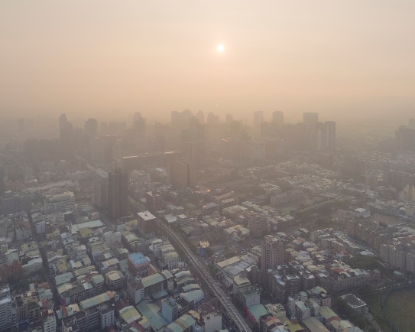
Air pollution in Taiwan
Notes:
Image: Flickr/CSL Media

Slide 11
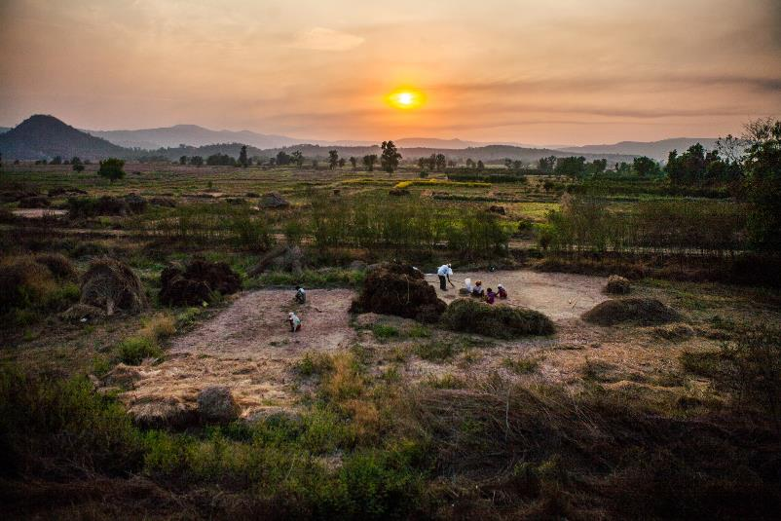
The view from the Konkan Railway in Maharashtra
Notes:
Image: Flickr/sandeepachetan.travel.com

Slide 12
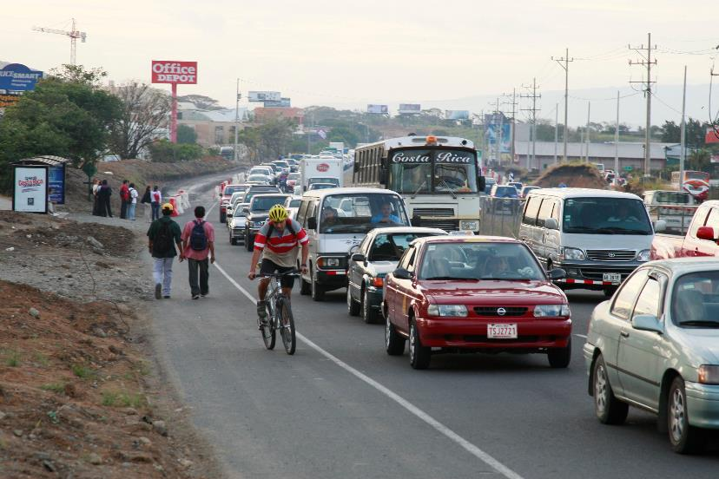
A road in Costa Rica
Notes:
Image: FIA Foundation/Richard Stanley

Slide 13
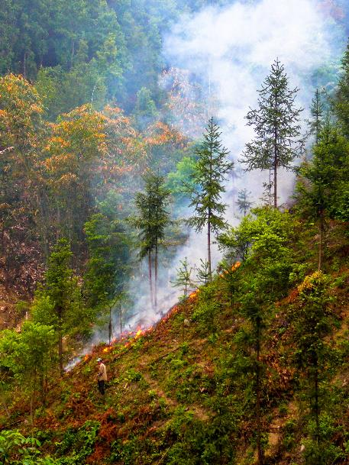
Clearing undergrowth in China
Notes:
Image: Flickr/Nick Hogarth/CFOR

Slide 14

Layers of inference
What other questions do I need to ask?
What doesn’t this source tell me?
What can I infer, what guesses can I make?
What does this source definitely tell me?
Source
E.g. map, photo,
quote etc

Slide 15
Question generator matrix
 | is | did | was | could | if
What
Where
Who
When
How
Why

Slide 16
Enquiry skills
Decide what, how, when and WHERE..
Use a mix of given and pupils’ own questions as a starting point.
How will we collect, analyse and present information?
Collaborating and Selecting
Asking
Doing
What have we learnt? How do we know? Has it changed our thinking and if so, how?
Reflecting
Evaluating
What have we found out?
Communicating
What do we do with this knowledge? Who can we share it with? And how?

Slide 17
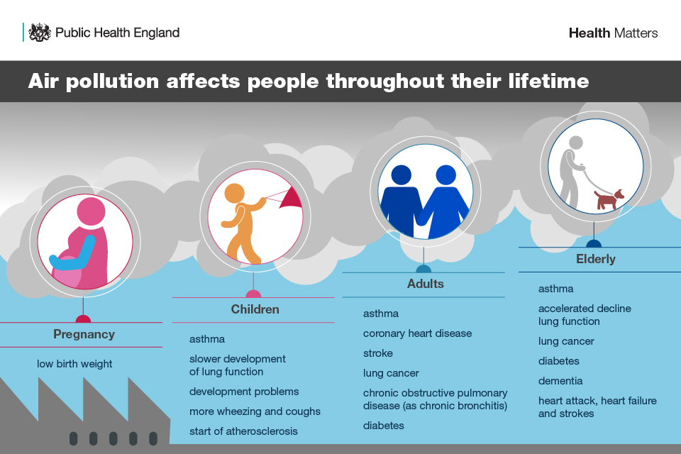
Notes:
Image: sourced from www.gov.uk/government/publications/health-matters-air-pollution/health-matters-air-pollution

Slide 18
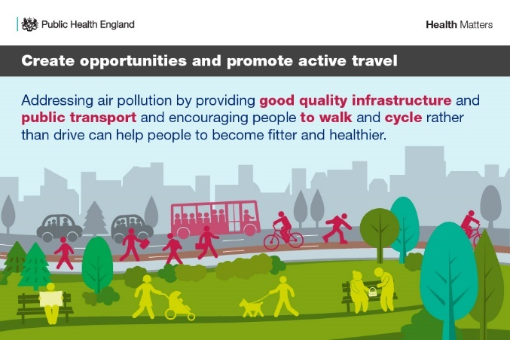
Notes:
Image: sourced from www.gov.uk/government/publications/health-matters-air-pollution/health-matters-air-pollution

Slide 19
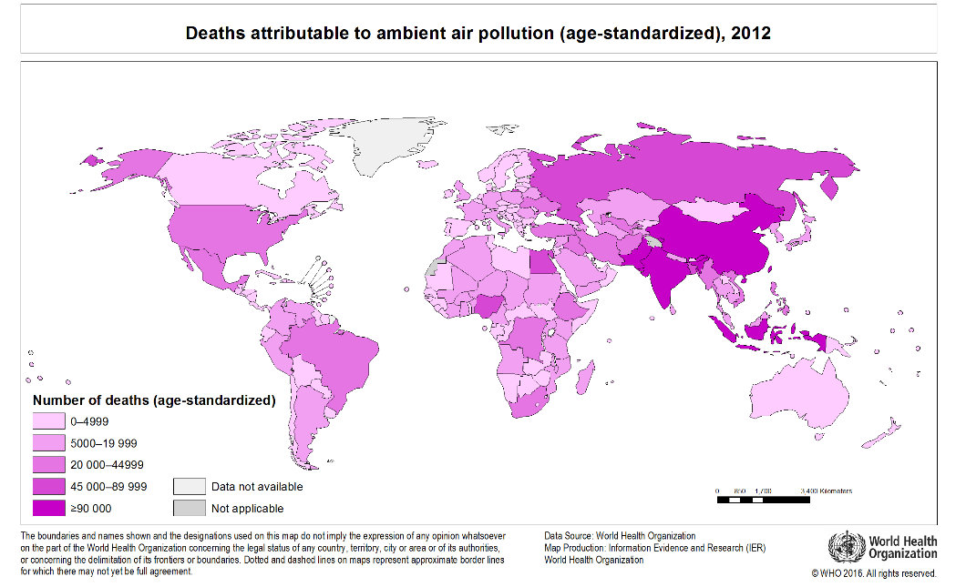
Notes:
Image: World Health Organisation (sourced from
http://gamapserver.who.int/mapLibrary/Files/Maps/Global_aap_deaths_age_standardized_2012.png?ua=1)

Slide 20
Air quality and pollution city ranking
21 January 2020
1 | Ulaanbaatar, Mongolia | 291
2 | Delhi, India | 237
3 | Hanoi, Vietnam | 185
4 | Mumbai, India | 182
5 | Kathmandu, Nepal | 176
6 | Wuhan, China | 168
7 | Hangzhou, China | 168
8 | Bishkek, Kyrgyzstan | 166
9 | Chengdu, China | 166
10 | Belgrade, Serbia | 159

