Slide 1

End Hunger
Schools Connect
Tackling hunger through creative collaboration

Slide 2
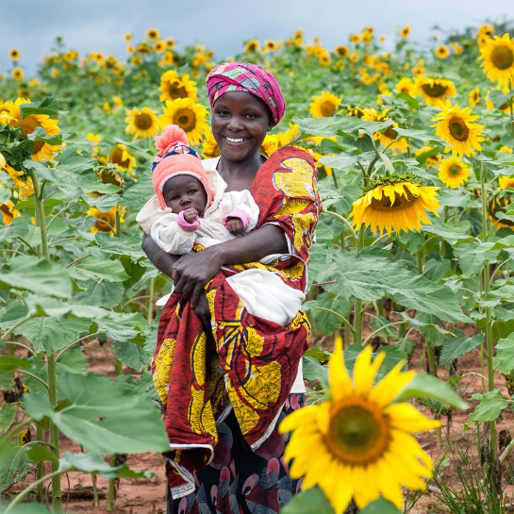
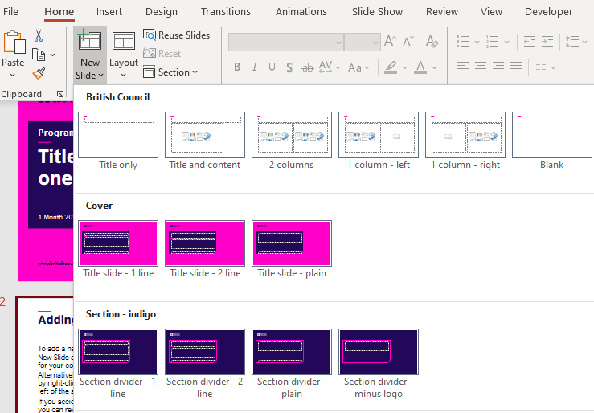
    These slides have been produced to support the End Hunger learning unit. They can only be used with the main resource, which includes full instructions on how to use them with your class and a partner school.
Notes:
Main photo credit: One Acre Fund
Source: https://www.facebook.com/oneacrefund/photos/pb.6040534532.-2207520000.1450268630./10153336345439533/?type=3&theater

Slide 3
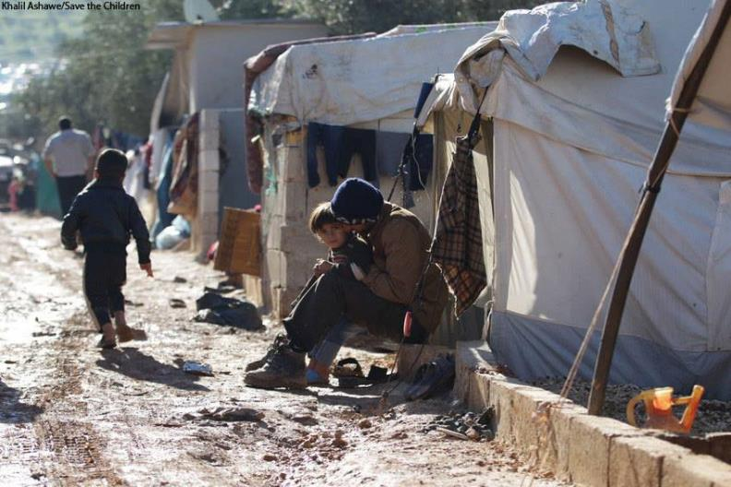
A camp for displaced people from Syria
Notes:
Photo credit: Save the Children UK
https://www.facebook.com/savethechildrenuk/photos/pb.117476785190.-2207520000.1450269123./10155113738060191/?type=3&theater
Behind the headlines of the ongoing #Syria conflict, it’s not hard to find the stories of the real Syrian people: the everyday acts of heroism and humanity that shine through this crisis. For every story of loss, there is the story of the doctor, teacher or volunteer who continues to provide care and hope to their community.
Find out more and read the story of siblings Adil and Tayyeb here >
http://blogs.savethechildren.org.uk/2015/01/syria-ordinary-people-doing-extraordinary-things/

Slide 4
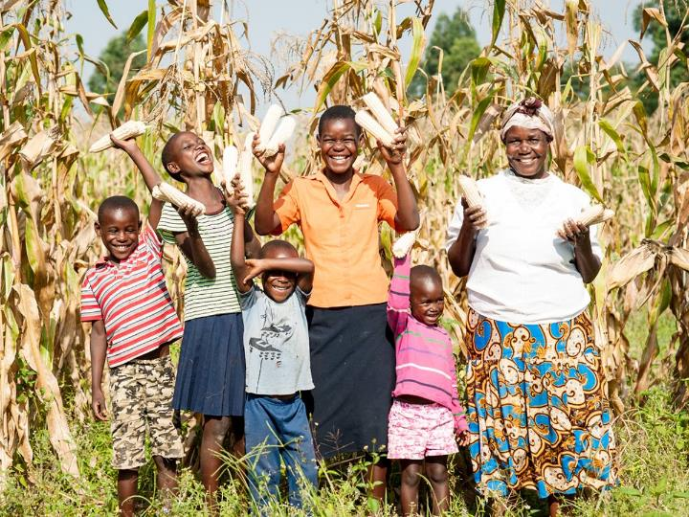
Farming family in Kenya
Notes:
Photo credit: One Acre Fund
Source: https://www.facebook.com/oneacrefund/photos/pb.6040534532.-2207520000.1450268624./10153669005809533/?type=3&theater
Notes: In 2010 after years of poor, insufficient harvests, Alice and Paul Barasa began farming with us. After just one season they were able to double their harvest, and now five years later, they harvest enough each season to feed and help educate their 14 grandchildren. Their remarkable story → http://bit.ly/1QwlL2V

Slide 5
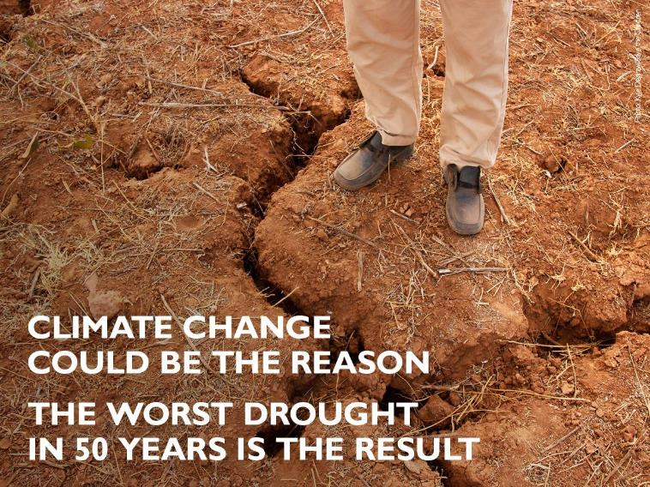
The worst drought in Ethiopia in 50 years
Notes:
Photo credit: Save the Children UK (December 2015)
Source: https://www.facebook.com/savethechildrenuk/photos/pb.117476785190.-2207520000.1450268370./10156308884055191/?type=3&theater
Notes: Ethiopia is facing the worst drought in 50 years. It has ruined harvests, devastated livestock and left families struggling to find food and water.
The Ethiopian government has launched a huge effort to tackle it - we’re doing all we can to help.
Together, we can stop the threat to children’s lives. Act now > http://save.tc/VC4OK

Slide 6
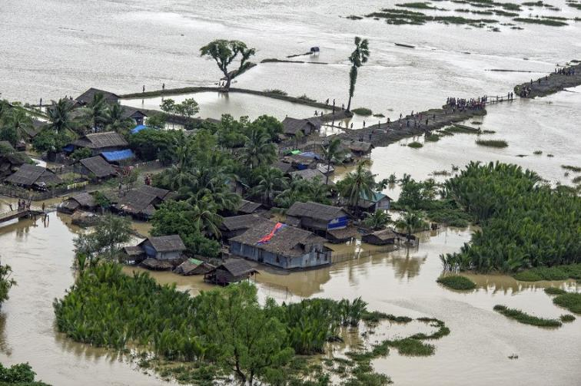
Floods in Myanmar
Notes:
Photo credit: Save the Children UK (August, 2015)
Source: https://www.facebook.com/savethechildrenuk/photos/pb.117476785190.-2207520000.1450268798./10155896450550191/?type=3&theater
Up to 80,000 children in flood-hit Myanmar are in need of essential hygiene and household items after floodwaters left entire communities underwater.
We’re giving out vital hygiene kits including soap and sanitary items to 150 families in Kayin State and working round the clock to assess the extent of the crisis and the needs of children and their families.

Slide 7
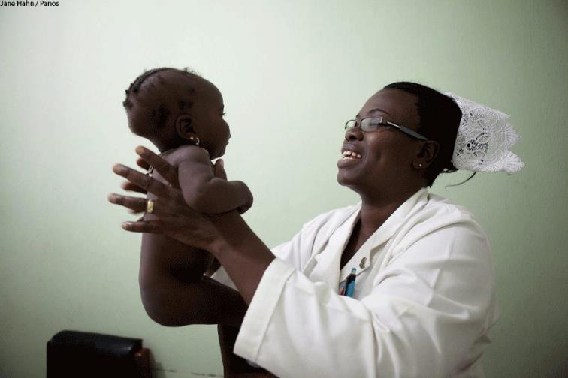
Health worker providing care to baby
Notes:
Photo credit: Save the Children UK
https://www.facebook.com/savethechildrenuk/photos/pb.117476785190.-2207520000.1450269113./10155423475830191/?type=3&theater
Notes: Happy World Health Workers Week!
Thank you to every amazing health worker around the world - like Catherine, who researches ways to improve essential newborn care and trains others to care for babies.
With your support, health workers like Catherine can change even more lives. Call on the UK government to strengthen health systems worldwide.

Slide 8
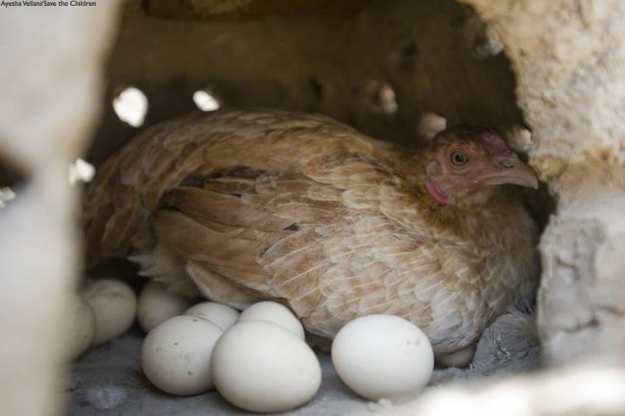
Improving nutritious diversity in diets
Notes:
Photo credit: Save the Children UK
Source: https://www.facebook.com/savethechildrenuk/photos/pb.117476785190.-2207520000.1450269122./10155220776390191/?type=3&theater
Notes: We're running livelihood projects to help improve the nutritious diversity in children´s diets and to provide families with additional income. Families benefiting from the poultry rearing project receive 30 chickens along with feeds and equipment to build chicken coups.

Slide 9
Learning outcomes
Critical thinking: develop a good understanding of the multiple causes and potential solutions to the challenge of hunger in different contexts
Creative collaboration: work in teams to design a mini-project to support better nutrition in the community
Notes:
Photo credit: Save the Children UK
Source: https://www.facebook.com/savethechildrenuk/photos/pb.117476785190.-2207520000.1450269122./10155220776390191/?type=3&theater
Notes: We're running livelihood projects to help improve the nutritious diversity in children´s diets and to provide families with additional income. Families benefiting from the poultry rearing project receive 30 chickens along with feeds and equipment to build chicken coups.

Slide 10
End Hunger
Schools Connect
Stories of progress

Slide 11
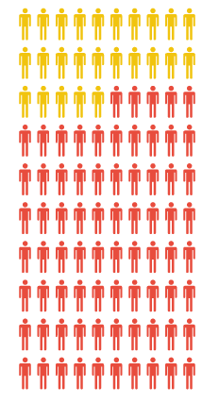
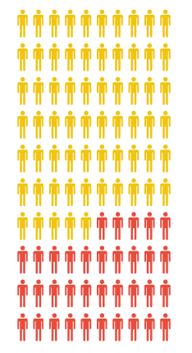
Progress in Ethiopia
In 1993, 75 out of 100 were undernourished
In 2013, 35 out of 100 were undernourished

Slide 12
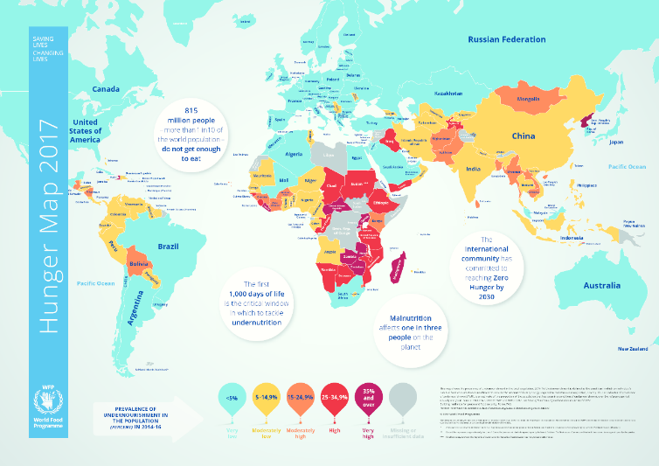
A deeper look at data about undernourishment
Notes:
Source: World Food Programme
http://documents.wfp.org/stellent/groups/public/documents/communications/wfp275057.pdf

Slide 13

Ending hunger is one of the global goals
Notes:
Source: http://www.globalgoals.org/

Slide 14
End Hunger
Schools Connect
One acre Fund

Slide 15
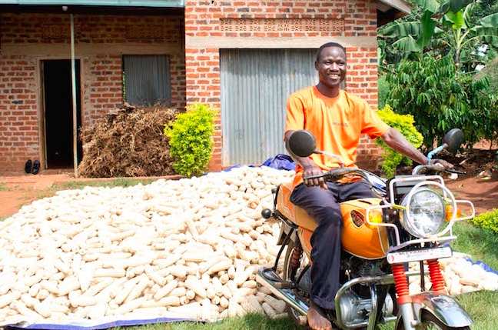
One Acre Fund’s work in Africa
Notes:
Source: One Acre Fund website: https://oneacrefund.org/articles/robert-tigarya-best-farmer-his-village
Notes: "This is the moment I've always dreamed about: becoming the best farmer in my village. I'm very happy.”
It hasn't been an easy journey, but over the last 6 years Robert Tigarya has developed into what he always believed he could be: the best farmer in his village.

Slide 16
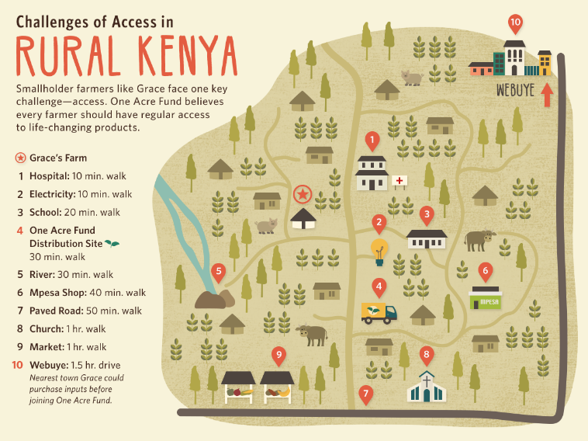
One Acre Fund’s work in Africa
Notes:
Source: One Acre Fund website: https://oneacrefund.org/articles/access-challenge-rural-kenya

Slide 17
One Acre Fund’s work in Africa
Healthy Nutrition
Immediate causes, such as what you eat
Intermediate causes, such as access to nutritious food
Underlying causes, such as poverty
Notes:
Source: One Acre Fund website: https://oneacrefund.org/articles/access-challenge-rural-kenya

Slide 18
End Hunger
Schools Connect
Three case studies

Slide 19
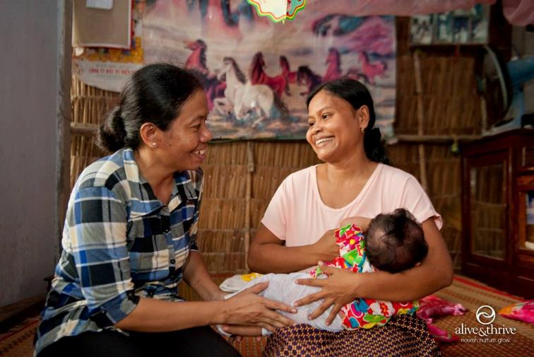
VietNam, Bangladesh & wealthy countries
Notes:
Photo credit: Alive & Thrive
Notes: Exclusive #breastfeeding rates tripled in #Vietnam! Read the press release here: https://www.aliveandthrive.org/en/news/a-year-in-publications-alive-thrives-annual-research-summary
Source: https://www.facebook.com/fhi360.aliveandthrive/photos/a.403927179681542.94093.400366110037649/771323606275229/?type=3&theater

Slide 20

What children can do to tackle hunger?
Notes:
Source: www.joshuasheart.org

Slide 21

Design For Change
Notes:
Source: Design For Change
https://www.dfcworld.org/SITE

