Slide 1

Zero waste – case studies
Schools Connect

Slide 2
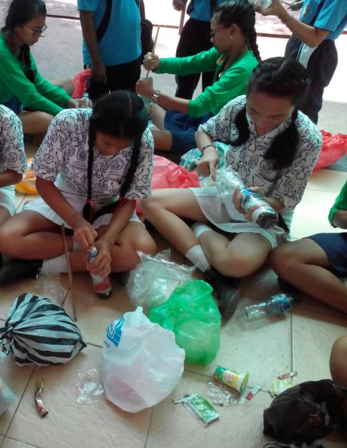
These slides have been produced to support the Zero Waste learning unit. They can only be used with the main resource, which includes full instructions on how to use them with your class and a partner school.
Notes:
Main photo credit: Ecobricks
Source: http://www.ecobricks.org/bali-ecobricks/

Slide 3
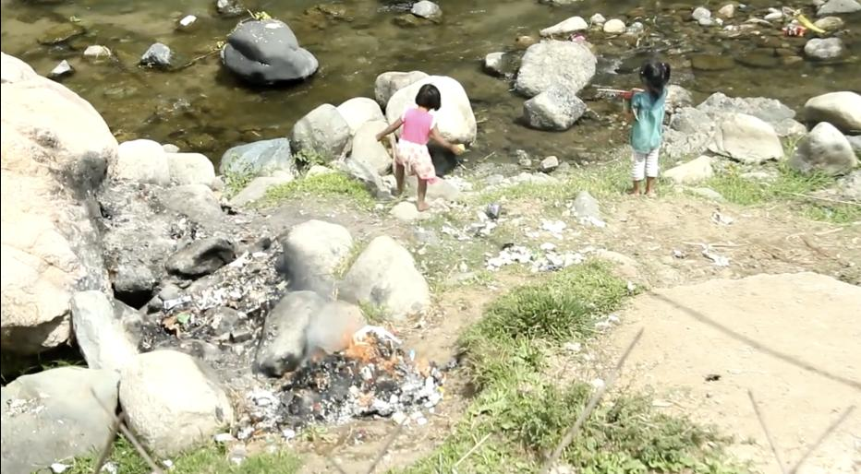
Vision Ecobricks
Notes:
Photo credit: screenshot from video below
Source: https://vimeo.com/91672621

Slide 4


Vision Ecobricks
Notes:
Photo credit: screenshot from video below
Source: https://vimeo.com/91672621
Notes: The Ecobrick guide is available in many different languages and can be downloaded here: http://www.ecobricks.org/download/

Slide 5
The percentage of plastic in a country’s waste composition
Notes:
Source: Waste Atlas
Available at: http://www.atlas.d-waste.com/visual_maps/Plastic.html

Slide 6
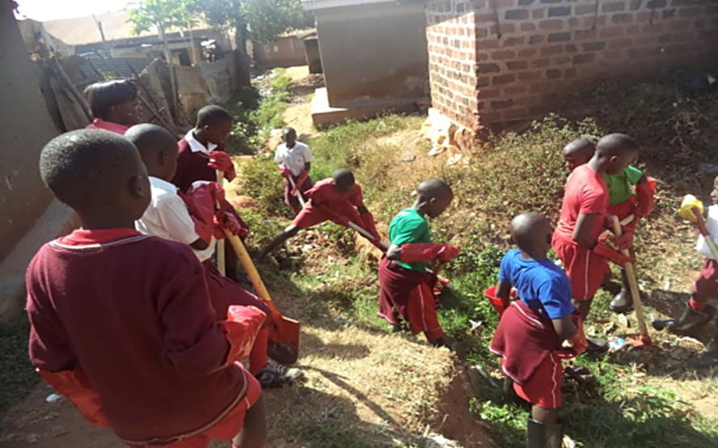
Less litter, Jojana Primary school, Uganda
Notes:
Source: Eco Schools: Global, Less Litter Campaign
Available at: https://esllc.exposure.co/jojana-primary-school

Slide 7


Towards Zero Waste, Sweden
Notes:
For younger children:
Video: Don’t waste your waste
Source: https://www.youtube.com/watch?v=Kr_DGf77OhM
For younger children:
Video: Don’t waste your waste
Source: https://www.youtube.com/watch?v=Kr_DGf77OhM

Slide 8
7 Steps
Step 1: Form an Eco Committee
Step 2: Carry out an Environmental Review
Step 3: Action Plan
Step 4: Monitor and Evaluate
Step 5: Curriculum Work
Step 6: Inform and Involve
Step 7: Produce an Eco Code
Notes:
Source: http://www.ecoschools.global
Notes: The most important aspect for schools to remember is that every school is different and it is therefore critical that a school fits the seven steps around its circumstances and situation and NOT try to fit the school into the seven steps. Some key points about the individual steps are below.

Slide 9
S… MART?
 | Specific | Measurable | Achievable | Realistic | Time-bound
Example
Notes:
Source: http://www.ecoschools.global
Notes: The most important aspect for schools to remember is that every school is different and it is therefore critical that a school fits the seven steps around its circumstances and situation and NOT try to fit the school into the seven steps. Some key points about the individual steps are below.
Source: http://www.ecoschools.global
Notes: The most important aspect for schools to remember is that every school is different and it is therefore critical that a school fits the seven steps around its circumstances and situation and NOT try to fit the school into the seven steps. Some key points about the individual steps are below.

Slide 10
SMART?
 | Specific | Measurable | Achievable | Realistic | Time-bound
Example | Reduce the amount of plastic bags and bottles that are littering our community by 50% and use to make Eco Bricks to build growing beds. | Currently, there is roughly 1 bottle for every square metre along the road side, and about 10 plastics bags. The road side will be clear each week and bins are full of plastic, not roadside. | Each class of children will take 10 metres of the areas outside of the school once per week. Bins will be erected at each corner and emptied by the Eco Committee and contents monitored. Bottles stuffed by volunteers from the community. | Not a lot! Need to speak to Eco Committee about: Sponsor a bin campaign? Make a bin? Training children to show community members how to make Eco Bricks. | Outside areas cleaned in 7 weeks time. Bins installed within three months. Local Recycling Manger collects once per month
Notes:
Source: http://www.ecoschools.global
Notes: The most important aspect for schools to remember is that every school is different and it is therefore critical that a school fits the seven steps around its circumstances and situation and NOT try to fit the school into the seven steps. Some key points about the individual steps are below.

Slide 11
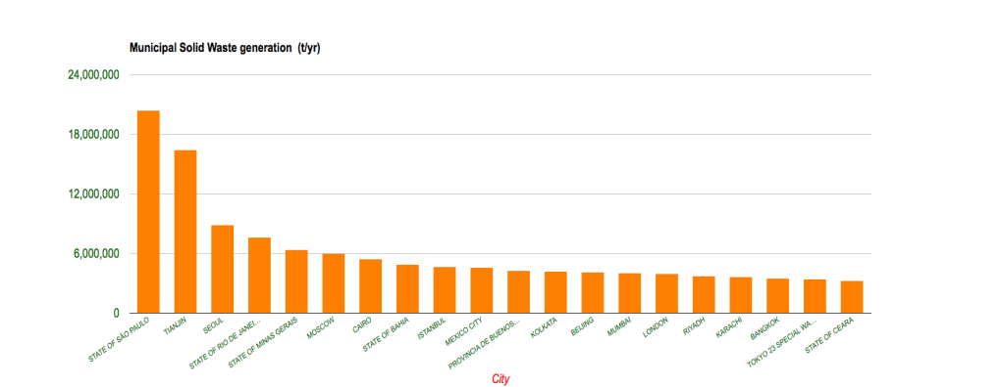
Recycling and waste data
Notes:
Source: Waste Atlas (http://www.atlas.d-waste.com)
Notes: The third looks at the top 20 cities in the world which have the highest level so waste generation. Are there any countries here which appear on both the country waste generation and recycling charts? Why might some cities be listed as the ‘worst offenders’ but the country it is in doe not appear on the country waste chart?

